Slide 1

Unit 3: Friends
Lesson 1.1: Grammar
Page 23

Slide 2
Lesson Outline
Warm-up
Vocabulary
Listening
Consolidation
Wrap-up

Slide 3

Objectives
By the end of this lesson, students will be able to…
ask & describe someone’s personal appearance.
practice writing description about a person.
Notes:
https://www.shutterstock.com/image-photo/hand-writing-inscription-objectives-marker-concept-385430380

Slide 4

WARM UP

Slide 5


Work in pairs
Ask & answer these questions:
What color is her hair?
Is her hair long or short?
Is she wearing glasses?
What color is her sweater?

Slide 6
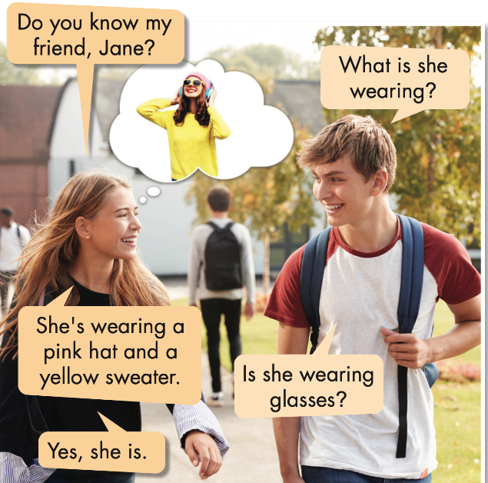

a. Listen and repeat.
1
2
3
4
5

Slide 7

Presentation

Slide 8

Structure: PRESENT CONTINUOUS
AM
IS
ARE

Slide 9
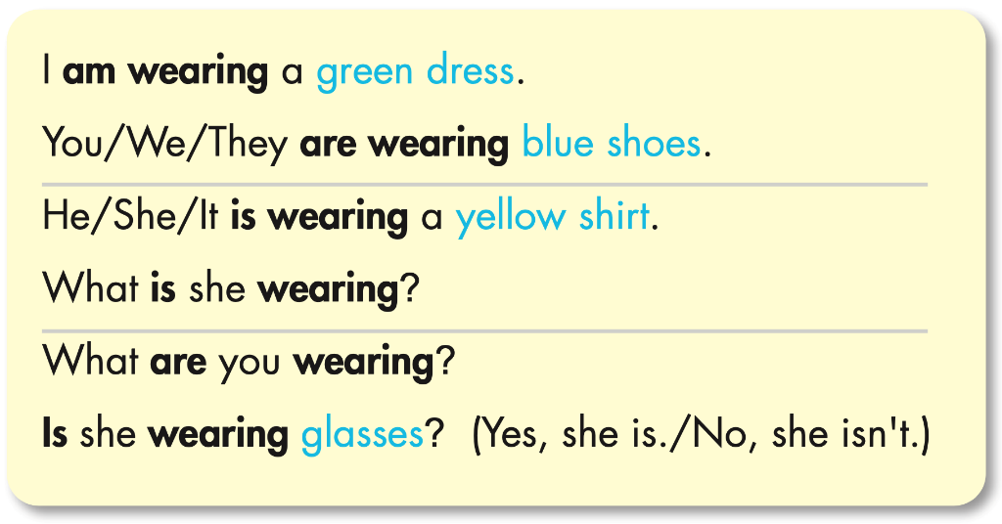




Structure: PRESENT CONTINUOUS
Work in pairs. Underline “BE” and circle subjects.

Slide 10
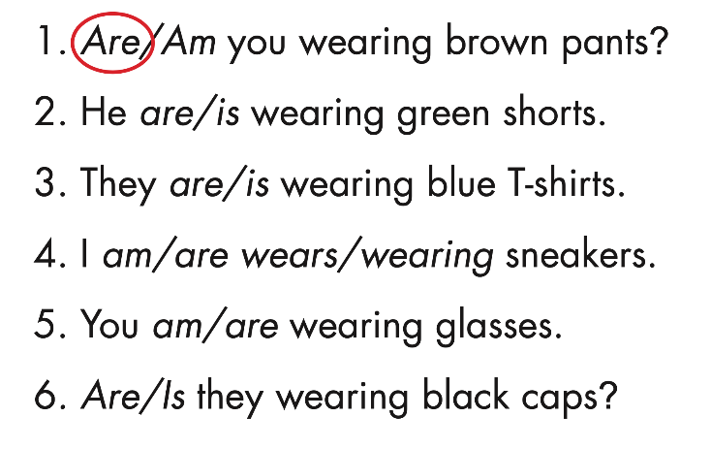


Structure: PRESENT CONTINUOUS
✍ b. Circle the correct words.

Slide 11
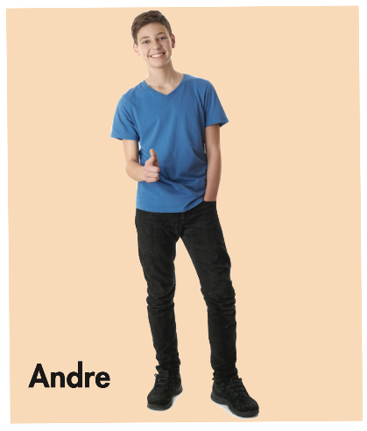
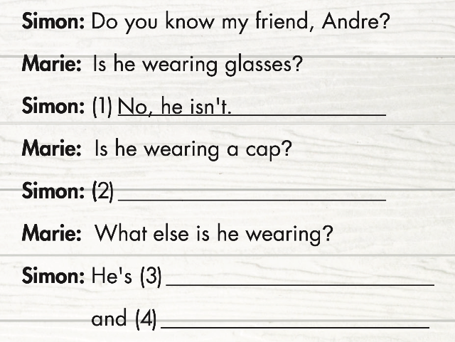
Structure: PRESENT CONTINUOUS
✍ c. Look at the photo and write Simon's answers.
No, he isn’t.
wearing a blue T-shirt
black pants

Slide 12
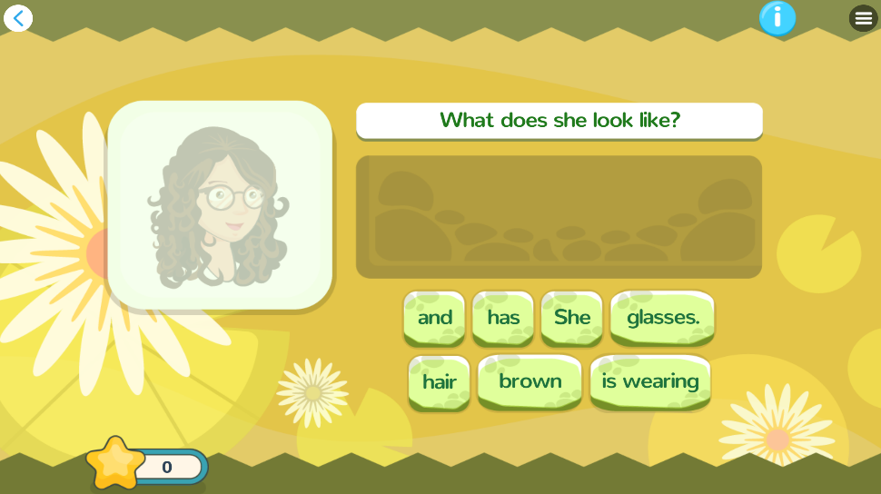
Extra Practice
DHA
Play the games in DHA App. Click the picture below.
Giúp mình add thêm vài trò chơi để HS nhận dạng, nhớ từ và phát âm đúng

Slide 13

Practice

Slide 14

Work in pairs. Underline the key words.
Extra Practice
WB page 15
We use adjectives to describe people‘s hair. When we use more than one adjective, we follow this order:

Slide 15
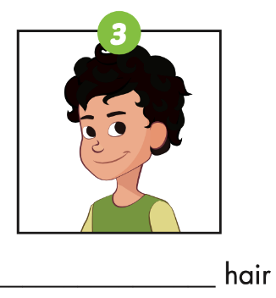
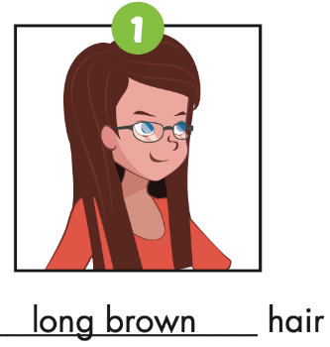
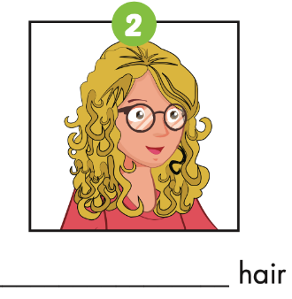
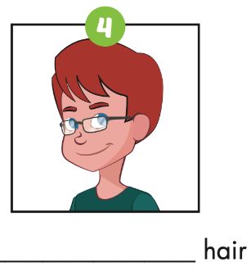
Extra Practice
WB page 15
Write the descriptions under the pictures.
short black
long blond
short red

Slide 16
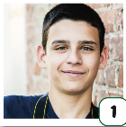
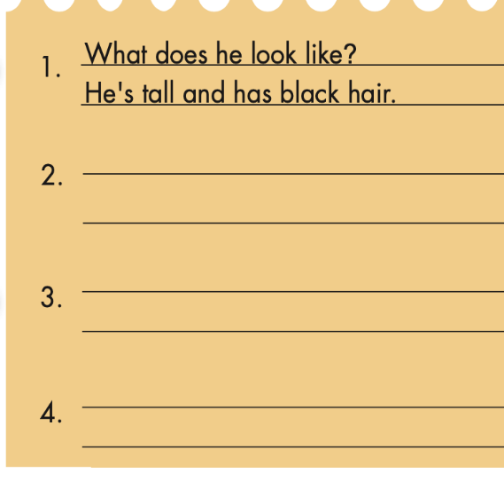


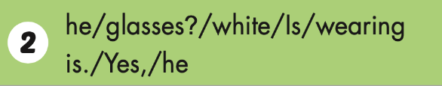



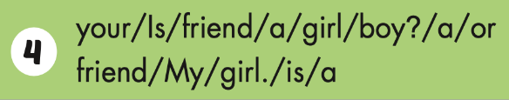
Extra Practice
WB page 15
b. Unscramble the sentences. Match the pictures to the descriptions.
Is he wearing white glasses?
Yes, he is.
What is she wearing?
She is wearing a blue dress.
Is your friend a boy or a girl?
My friend is a girl.

Slide 17

Production

Slide 18
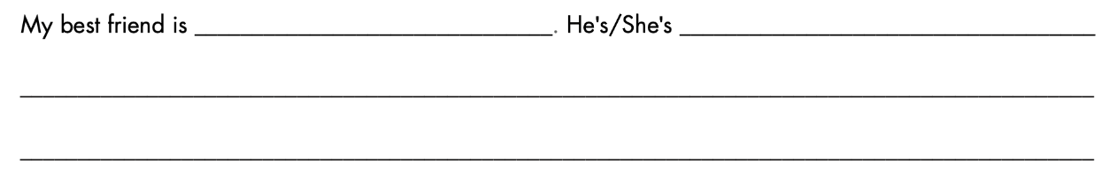
Writing
Write a description of a student in your class. Write 40 to 50 words.

Slide 19

CONSOLIDATION

Slide 20
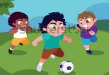
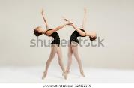



Look at the pictures. Complete the following sentences using appropriate present continuous tense forms.
are playing
1. The boys --------------------- (play) in the garden.
are dancing
2. The girls -------------------- (dance).
am counting
3. I -------------------- (count) the numbers.
is doing
4. He ------------------ (do) his homework.
are waiting
5. They -------------------- (wait) for us.
Notes:
https://www.shutterstock.com/image-vector/cute-boys-playing-soccer-outdoors-vector-1540294883
https://www.shutterstock.com/image-photo/ballet-dancer-on-white-background-723352360
https://www.shutterstock.com/image-photo/asian-little-chinese-girl-doing-mathematics-1116676709
https://www.shutterstock.com/image-photo/two-aussie-puppies-red-merle-tricolor-2097191944

Slide 21

WRAP-UP

Slide 22
Lesson 3
Today’s lesson
Grammar
What does he/she look like?
What color is …?
What is he/she wearing?
Is he/she ….?
Yes, he/she is./ No, he/she isn’t.

Slide 23
Lesson 3
Homework
Learn by hearts vocabularies and make sentences using them.
Do the exercises on page 15 WB
Complete the grammar notes in Tiếng Anh 6 i-Learn Smart World Notebook on page 15.
Prepare the next lesson (page 16 SB)
Play the consolidation games in Tiếng Anh 6 i-Learn Smart World DHA App on www.eduhome.com.vn

Slide 24
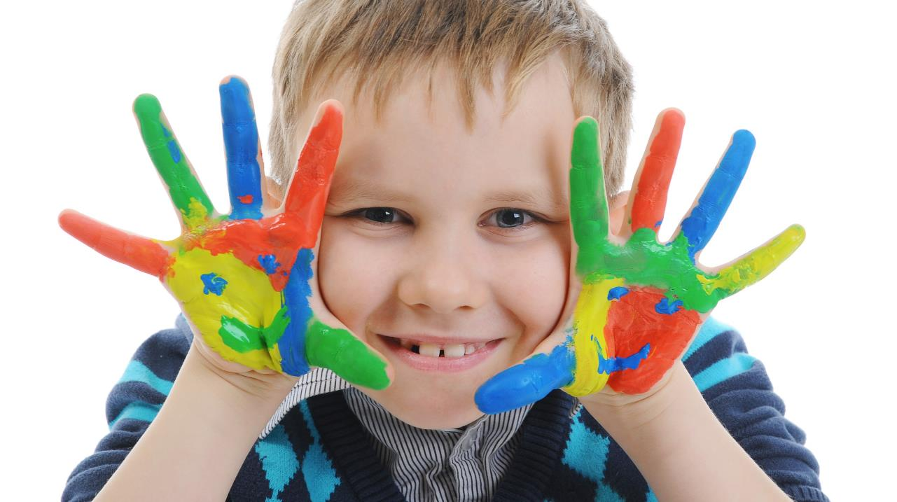
Enjoy your day!

