Slide 1

Unit 2: Health
Review
Page 86-87

Slide 2






REVIEW OUTLINE
Vocabulary
Wrap-up

Slide 3

By the end of this lesson, students will be able to…
- review vocabularies and grammar points.​
- practice reading for specific information.​
- practice listening for detail.

Slide 4

WARM UP

Slide 5
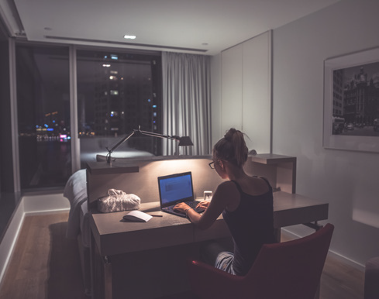
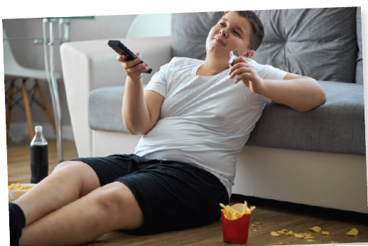
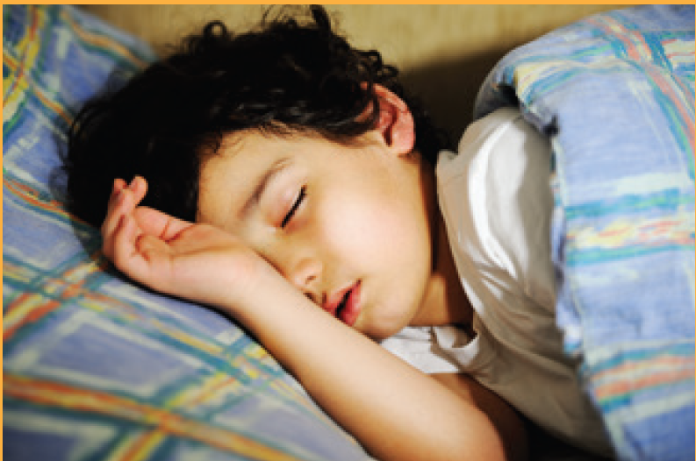
a. Name the activities in the following photos.
1. staying ____ ____
up late
2. watching _______
TV
https://www.shutterstock.com/image-photo/young-handsome-man-falling-asleep-during-1265561959
4. Going __________
asleep
sleep / bed
Click here for the answers.
3. Falling __________

Slide 6

REVIEW

Slide 7

PRE-LISTENING
You will hear a doctor talking to a group of students about staying healthy. Listen and fill in the blanks. You will hear the information twice.
Tips: Before listening, you should expect the right word class in each blank. It might be a noun, an adjective, a verb, an adverb or even a number.
Example: Name of doctor: (0) Brown
→ (0) needs a noun.

Slide 8
PRE-LISTENING
Teenagers and Sleep
Name of doctor: (0) Brown
Important to get: (1) _______________ hours of sleep
Difficult to sleep before: (2) _______________ p.m.
Teenagers getting enough sleep: (3) _______________ %
Shouldn't eat or: (4) _______________ before bed
Relax before bed by: (5) _______________
[number]
[time]
[a number]
[a bare infinitive]
[a V-ing]

Slide 9

WHILE-LISTENING
Click here for the audio.
Teenagers and Sleep
Name of doctor: (0) Brown
Important to get: (1) _______________ hours of sleep
Difficult to sleep before: (2) _______________ p.m.
Teenagers getting enough sleep: (3) _______________ %
Shouldn't eat or: (4) _______________ before bed
Relax before bed by: (5) _______________
8 / eight
11
15
exercise
reading (a book)
Click here for the answers.

Slide 10
THE AUDIO SCRIPT
Click here for the audio.
Doctor: Hello, everyone. I'm Doctor Brown and today I want to talk to you about how to prepare yourself for a good night's sleep. It's important
to get at least eight hours of sleep each night, but lots of teenagers and it difficult to fall asleep before eleven o'clock at night.
One study found that only fifteen percent of teenagers get enough sleep. So, what can you do to get more sleep? Well, you shouldn't eat or
exercise for a few hours before bed. You should also do something
to relax before you go to bed, like reading a book. If you read a book before going to sleep, then you will sleep better than if you watch TV or
play online games.

Slide 11
POST-LISTENING
Pair-work: Discussion
What do you often do before going to bed?
Do you want to try Doctor Brown’s advice? Why / why not?

Slide 12

PRE-READING
Tips: The answers are in the same order as the questions.
There are FOUR paragraphs. Question 0 is an example. It needs the key words in the first paragraph. Sometimes you cannot find the correct option in the text.
0. What isn't a result of an unhealthy lifestyle?
A. not having enough energy
B. becoming fat
C. finding it difficult to sleep
Option C is not in the first paragraph.
Click here for the answers.
Having a healthy lifestyle is very important. Unhealthy habits will make you feel tired and increase your chance of becoming overweight. Here are some things you should pay attention to:

Slide 13
WHILE-READING
Choose the correct answer (A, B, or C).
Teenagers: How to Stay Healthy
Having a healthy lifestyle is very important. Unhealthy habits will make you feel tired and increase your chance of becoming overweight. Here are some things you should pay attention to:
• Eat many types of food and try to eat more fruit and vegetables. Many teens like fast food and soda, but they're really bad for you. You don't have to stop eating your favorite burgers completely, but try to eat them less.
• Exercise regularly. You should get an hour of exercise a day. If you can't, try to be active for at least half an hour three times a week.
• Get enough sleep. You shouldn't stay up late too often. Your body needs about nine hours of sleep every night, but most teens have only about seven hours of sleep. Having enough sleep will help you focus and remember things more easily.

Slide 14
Tips: There are FOUR paragraphs. Question 0 is an example. It needs the key words in the first paragraph. Sometimes you cannot find the correct option in the text.
0. What isn't a result of an unhealthy lifestyle?
A. not having enough energy
B. becoming fat
C. finding it difficult to sleep
Teenagers: How to Stay Healthy
Having a healthy lifestyle is very important. Unhealthy habits will make you feel tired and increase your chance of becoming overweight. Here are some things you should pay attention to:
Click here for the answers.

Slide 15
Tips: Question 1 needs the key words in the next paragraph.
1. What does the article say about healthy eating?
A. Never eat fast food
B. Eat many different kinds of food
C. Eat more fruit and vegetables than meat
• Eat many types of food and try to eat more fruit and vegetables. Many teens like fast food and soda, but they're really bad for you. You don't have to stop eating your favorite burgers completely, but try to eat them less.
Click here for the answers.

Slide 16
Tips: The key words for question 2, 3 and 4 are in paragraph 3 and 4.
2. What's the least amount of exercise teens should get?
A. 30 minutes three times a week
B. 60 minutes three times a week
C. 60 minutes every day
• Exercise regularly. You should get an hour of exercise a day. If you can’t,
try to be active for at least half an hour three times a week.
• Get enough sleep. You shouldn't stay up late too often. Your body needs about nine hours of sleep every night, but most teens have only about seven hours of sleep. Having enough sleep will help you focus and remember things more easily.
Click here for the answers.

Slide 17
3. How much sleep do most teens get each night?
A. seven hours B. eight hours C. nine hours
4. What isn't a benefit of having enough sleep?
A. Your body will be stronger.
B. You can focus better.
C. Your memory will be better.
• Get enough sleep. You shouldn't stay up late too often. Your body needs about nine hours of sleep every night, but most teens have only about seven hours of sleep. Having enough sleep will help you focus and remember things more easily.
Click here for the answers.

Slide 18
POST-READING
Pair-work: Discussion
1. Can you follow the advice of the text? Why / why not?
2. Do you have any other advice? If so, please share it with your partner.

Slide 19

Vocabulary
Click here for the answers.
Fill in the blanks with the words from the box.
stay up late eat fruit and vegetables get some sleep
take your medicine has a sore throat unhealthy
take vitamins keep warm
1. It's 11 p.m., Mandy! You shouldn't ________________.
2. Most people don't need to ________________ because they can get enough vitamins from their food already.
3. It's very important to ________________ during winters.
4. We'll need to wake up at 4 a.m. tomorrow. Try to ________________ now.
stay up late
take vitamins
keep warm
get some sleep

Slide 20
Click here for the answers.
stay up late eat fruit and vegetables get some sleep
take your medicine has a sore throat unhealthy
take vitamins keep warm
5. Matt's lifestyle is really _____________________. He doesn't exercise and eats lots of burgers and pizzas.
6. Don't forget to _____________________ after lunch. The doctor said you should eat some food before taking it.
7. Jane _____________________. It hurts when she eats or talks.
8. A good way to get your kids to _____________________ is to add some to their favorite dishes.
unhealthy
take your medicine
has a sore throat
eat fruit and vegetables

Slide 21

a. Circle the correct words.
1. Can you go buy some/much milk, please?
We don't have some/any left.
2. I eat lots of/any vegetables every day.
3. Ben doesn't do any/a little exercise. He's very lazy.
4. My parents let me watch a little/any TV every day.
5. You should drink lots of/any water every day.
Click here for the answers.

Slide 22
b. Unscramble the sentences.
Click here for the answers.
1. shouldn't/TV./You/much/watch/too
_________________________________________________________
2. do/What/should/healthier?/I/to/become
_________________________________________________________ 3. exercise./He/much/do/doesn't
_________________________________________________________
4. get/a/Teens/hours/night./nine/should/sleep/of
_________________________________________________________
5. of/shouldn't/candy./You/eat/lots
_________________________________________________________
You shouldn’t watch too much TV.
What should I do to become healthier?
He doesn’t do much exercise.
Teens should get a nine hours of sleep a night.
You shouldn’t eat lots of candy.

Slide 23

Click here for the answers.
a. Circle the word that has the underlined part pronounced differently
from the others.
1. A. take B. stay C. late D. soda
2. A. fever B. rest C. vegetable D. medicine
3. A. candy B. fast food C. warm D. have

Slide 24
Click here for the answers.
b. Circle the word that differs from the other three in the position of primary stress in each of the following questions.
4. A. medicine B. unhealthy C. vitamin D. vegetable
5. A. lifestyle B. fever C. lazy D. enough
6. A. cafeteria B. stomachache C. restaurant D. exercise

Slide 25

WRAP-UP

Slide 26
Today’s lesson
- review vocabularies and grammar points.​
- practice reading for specific information.​
- practice listening for detail.

Slide 27
Homework
Do the Review exercise in Workbook, page 63.
Review all vocabularies and grammar points in Unit 2.
Prepare Unit 3 (page 20 SB).
Play the consolidation games in Tiếng Anh 7 i-Learn Smart World DHA App on www.eduhome.com.vn

Slide 28

Lesson 3
Stay positive and have a nice day!

