Slide 1

Unit 8: Festivals around the World
Lesson 3.2: Writing
Page 67

Slide 2


Lesson 3.2
LESSON OUTLINE
Consolidation

Slide 3

By the end of this lesson, students will be able to…
write a blog post about a festival.
talk about favorite festivals.

Slide 4
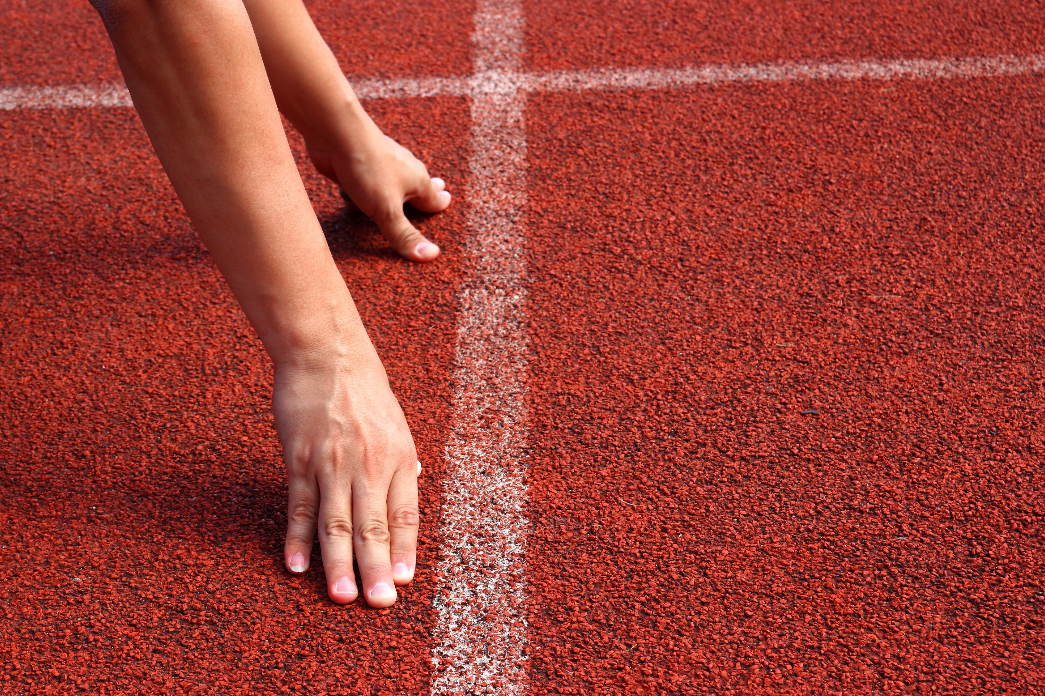
WARM UP

Slide 5

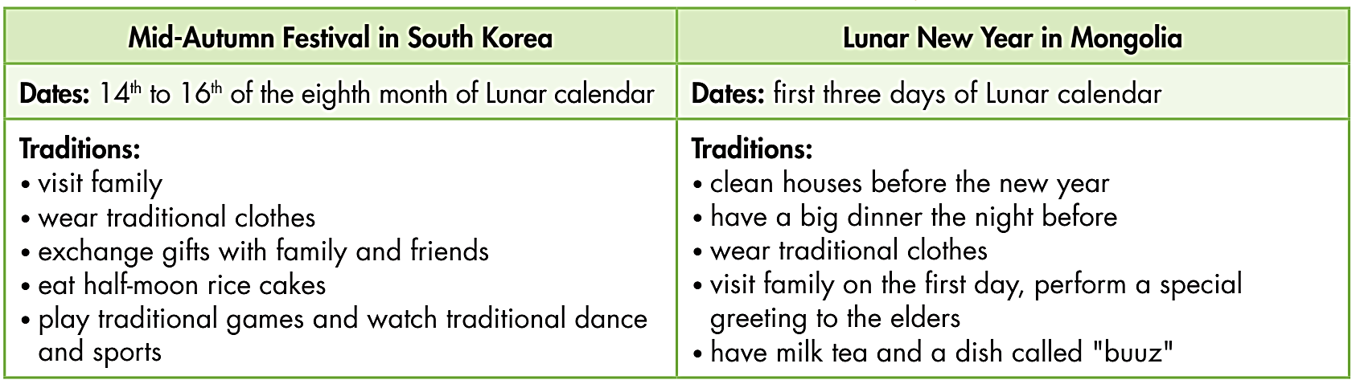
Work in pairs. Choose either South Korea or Mongolia and tell your partner about its traditions.
Mongolians celebrate the Lunar New Year on the first three days of Lunar calendar. They …

Slide 6


It’s time to write….

Slide 7

Pre - writing
a. Read about writing festival blog posts.
Writing blog posts about festivals To write a good blog post about a festival, you should:
Begin with a title – The name of the festival: The Hội An Lantern Festival
Describe the location – Where the festival is: The festival takes place in Hội An Old Town.
Say when it happens– The date(s) of the festival: every month/January/Autumn
Explain the history (optional): The festival started in 1998 to celebrate the monthly full moon.
Add extra details – The things that happen in the festival: During the festival, the local people light colorful lanterns.
Give an opinion (optional): It is a very beautiful festival.

Slide 8
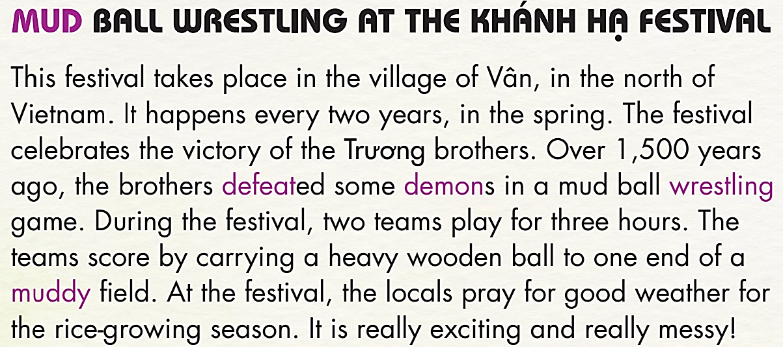
Read the blog post about the Khánh Hạ Festival again and circle the information about the festival's history.
This festival takes place in the village of Vân, in the north of Vietnam. It happens every two years, in the spring.
The festival celebrates the victory of the Trương brothers. Over 1,500 years ago, the brothers defeated some demons in a mud ball wrestling game.
During the festival, two teams play for three hours. The teams score by carrying a heavy wooden ball to one end of a muddy field. At the festival, the locals pray for good weather for the rice-growing season. It is really exciting and really messy!

Slide 9
IMPORTANT PARTS OF A BLOG POST
2. Describe the location: Where the festival is.
1. Begin with a title: The name of the festival.
This festival takes place in the village of Vân, in the north of Vietnam. It happens every two years, in the spring.
The festival celebrates the victory of the Trương brothers. Over 1,500 years ago, the brothers defeated some demons in a mud ball wrestling game.
During the festival, two teams play for three hours. The teams score by carrying a heavy wooden ball to one end of a muddy field. At the festival, the locals pray for good weather for the rice-growing season. It is really exciting and really messy!
3. Say when it happen: The date(s) of the festival
5. Add extra details: The things that happen in the festival
4. Explain the history:
6. Give an opinion (optional):

Slide 10
Making 6 questions about a festival:
Begin with a title – The name of the festival: ___________________________
Describe the location – Where the festival is: ___________________________
Say when it happens– The date(s) of the festival: ________________________
Explain the history (optional): _______________________________________
Add extra details – The things that happen in the festival: _________________
Give an opinion (optional): _________________________________________
What’s the name of the festival?
Where is the festival?
When does it take place?
Why does the festival happen?
What do people do in the festival?
What do you think of the festival?

Slide 11
Use the questions to ask and answer about Hội An Lantern Festival. Try to give full answers.
What’s the name of the festival? Why does the festival happen? Where is the festival? What do people do in the festival? When does the festival take place? What do you think of the festival?
Begin with a title – The name of the festival: The Hội An Lantern Festival
Describe the location – Where the festival is: The festival takes place in Hội An Old Town.
Say when it happens– The date(s) of the festival: every month/January/Autumn
Explain the history (optional): The festival started in 1998 to celebrate the monthly full moon.
Add extra details – The things that happen in the festival: During the festival, the local people light colorful lanterns.
Give an opinion (optional): It is a very beautiful festival.

Slide 12
While - writing
b. Reorder this festival blog post. Use the skill box to help you.
 On this day, people remember the Hùng Kings. The Hùng Kings are the first kings of the nation.  During the festival, people wear colorful, traditional clothes and pray at temples.  It happens in the spring and lasts a few weeks.  The Hùng Kings Festival  It is a fun and relaxing time for families.  The Hùng Kings Festival takes place all over Vietnam.
4
5
3
1
6
2

Slide 13
Reorder this festival blog post, then write about the festival:
Extra Practice
WB, page 49
People celebrate victory over the Chinese army.
The Tây Sơn Festival is really exciting. During the festival, there are many martial art performances. People play with fighting sticks and quyền (a kind of Vietnamese kung fu). There is also a drum competition. The Tây Sơn Festival The Tây Sơn Festival takes place in January in Bình Định Province, Vietnam.
Rewrite
The Tây Sơn Festival
The Tây Sơn Festival takes place in January in Bình Định Province, Vietnam.
People celebrate victory over the Chinese army.
During the festival, there are many martial art performances. People play with fighting sticks and quyền (a kind of Vietnamese kung fu). There is also a drum competition.
The Tây Sơn Festival is really exciting.

Slide 14

a. You want to know which festival your friend likes. In pairs: Ask your partner about their favorite festival. Use these questions:
What’s the name of the festival? Why does the festival happen? Where does it happen? What do people do in the festival? When does it take place? What do you think of the festival?

Slide 15
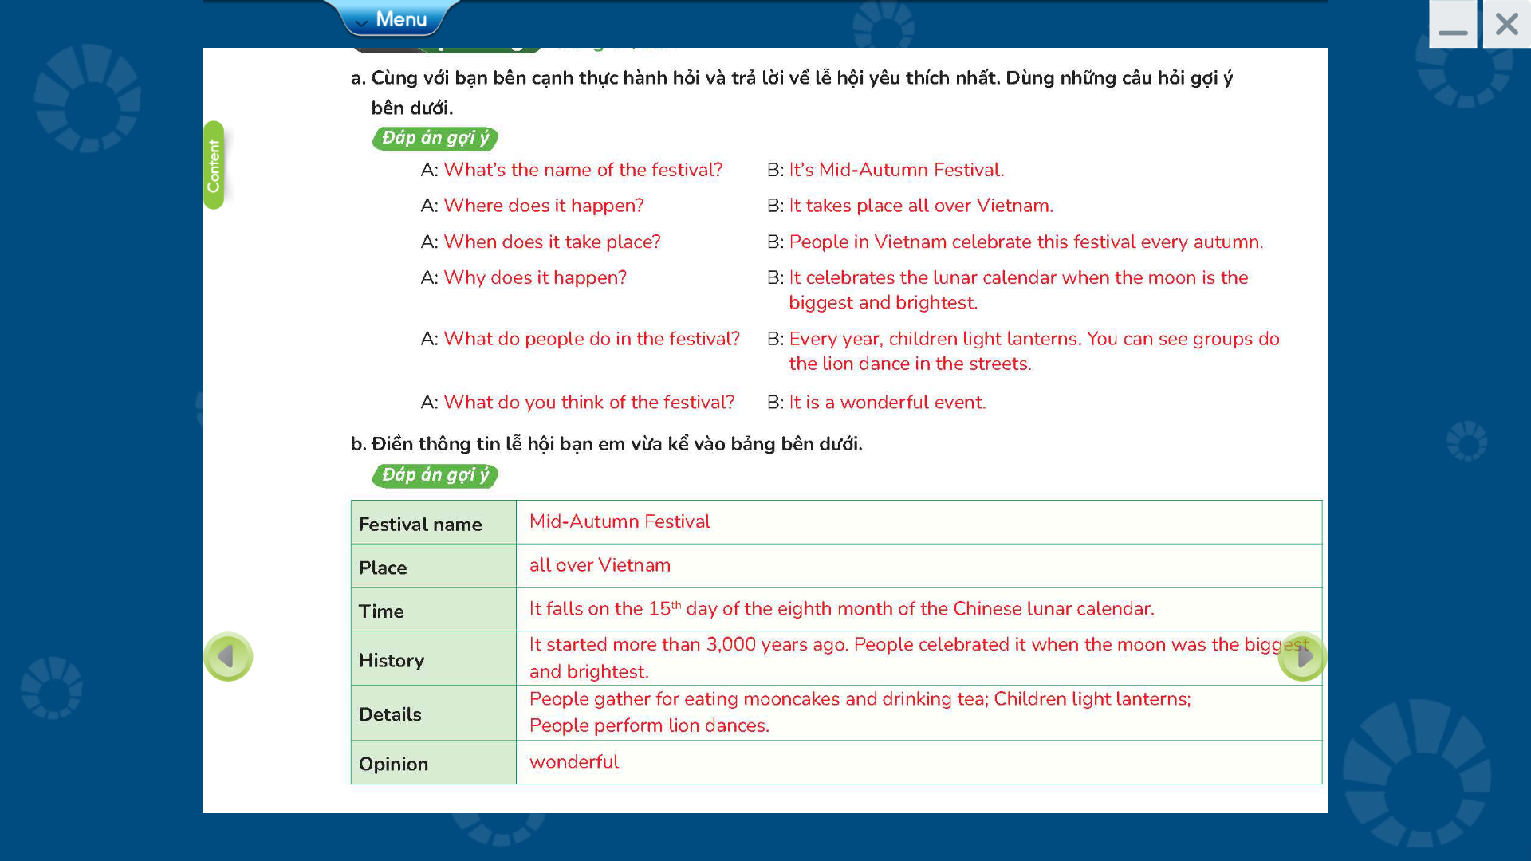

Slide 16
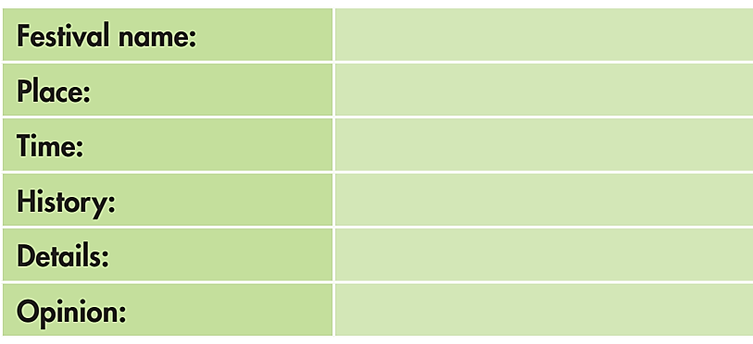
b. Now, think about your favorite festival. Make notes in the table below:

Slide 17

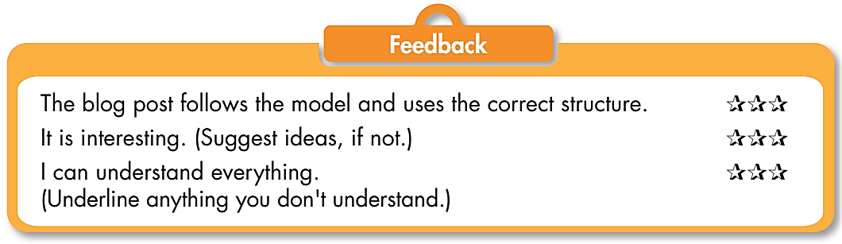
Post - writing
Now, write a blog post about your favorite festival. Use the Feedback form to help you. Write 60 to 80 words.

Slide 18
Sample answer
Mid-Autumn Festival
The Mid-Autumn Festival is my favorite festival. It is a big festival and takes place all over Vietnam. People in Vietnam celebrate this festival every autumn. It celebrates the lunar calendar when the moon is the biggest and brightest. These days, Mid-Autumn Festival in Vietnam is very important for children. Every year, children light lanterns. Lion dances are also very popular. You can see groups do the lion dance in the streets. It is a wonderful event.

Slide 19

CONSOLIDATION

Slide 20
WHAT CAN YOU REMEMBER?
Tell your partner about 6 steps to write a blog post about a festival.
Begin with a title – The name of the festival.
Describe the location – Where the festival is.
Say when it happens– The date(s) of the festival.
Explain the history (optional).
Add extra details – The things that happen in the festival.
Give an opinion (optional).

Slide 21

WRAP-UP

Slide 22
Today’s lesson
Writing:
- Understand steps to write about a festival.
Practice writing a blog post.
Speaking:
- Talk about favorite festivals.

Slide 23
Homework
Finish page 49, WB.
Complete the writing notes in Tiếng Anh 7 i-Learn Smart World Notebook on page 53.
Play the consolidation games in Tiếng Anh 7 i-Learn Smart World on www.eduhome.com.vn
Prepare Review Unit 8 (page 104-105, SB).

Slide 24

Lesson 3
Stay positive and have a nice day!

