Slide 1
Unit 1: Free Time
Lesson 1.1: Vocab & Reading
Pages 4 & 5

Slide 2
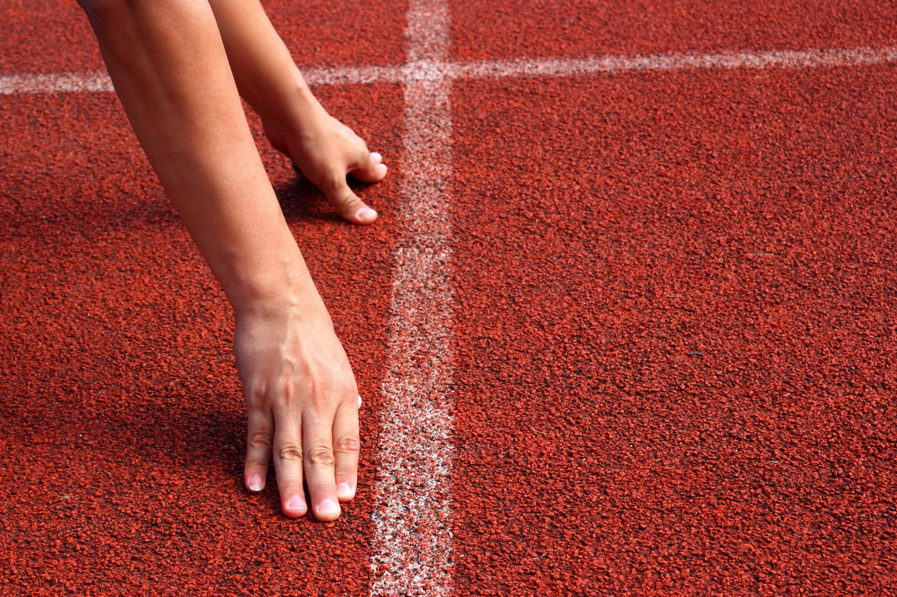
WARM UP

Slide 3
Let’s talk:
What do the girls like doing in their free time?
What do you do in your free time? How often do you do it?

Slide 4
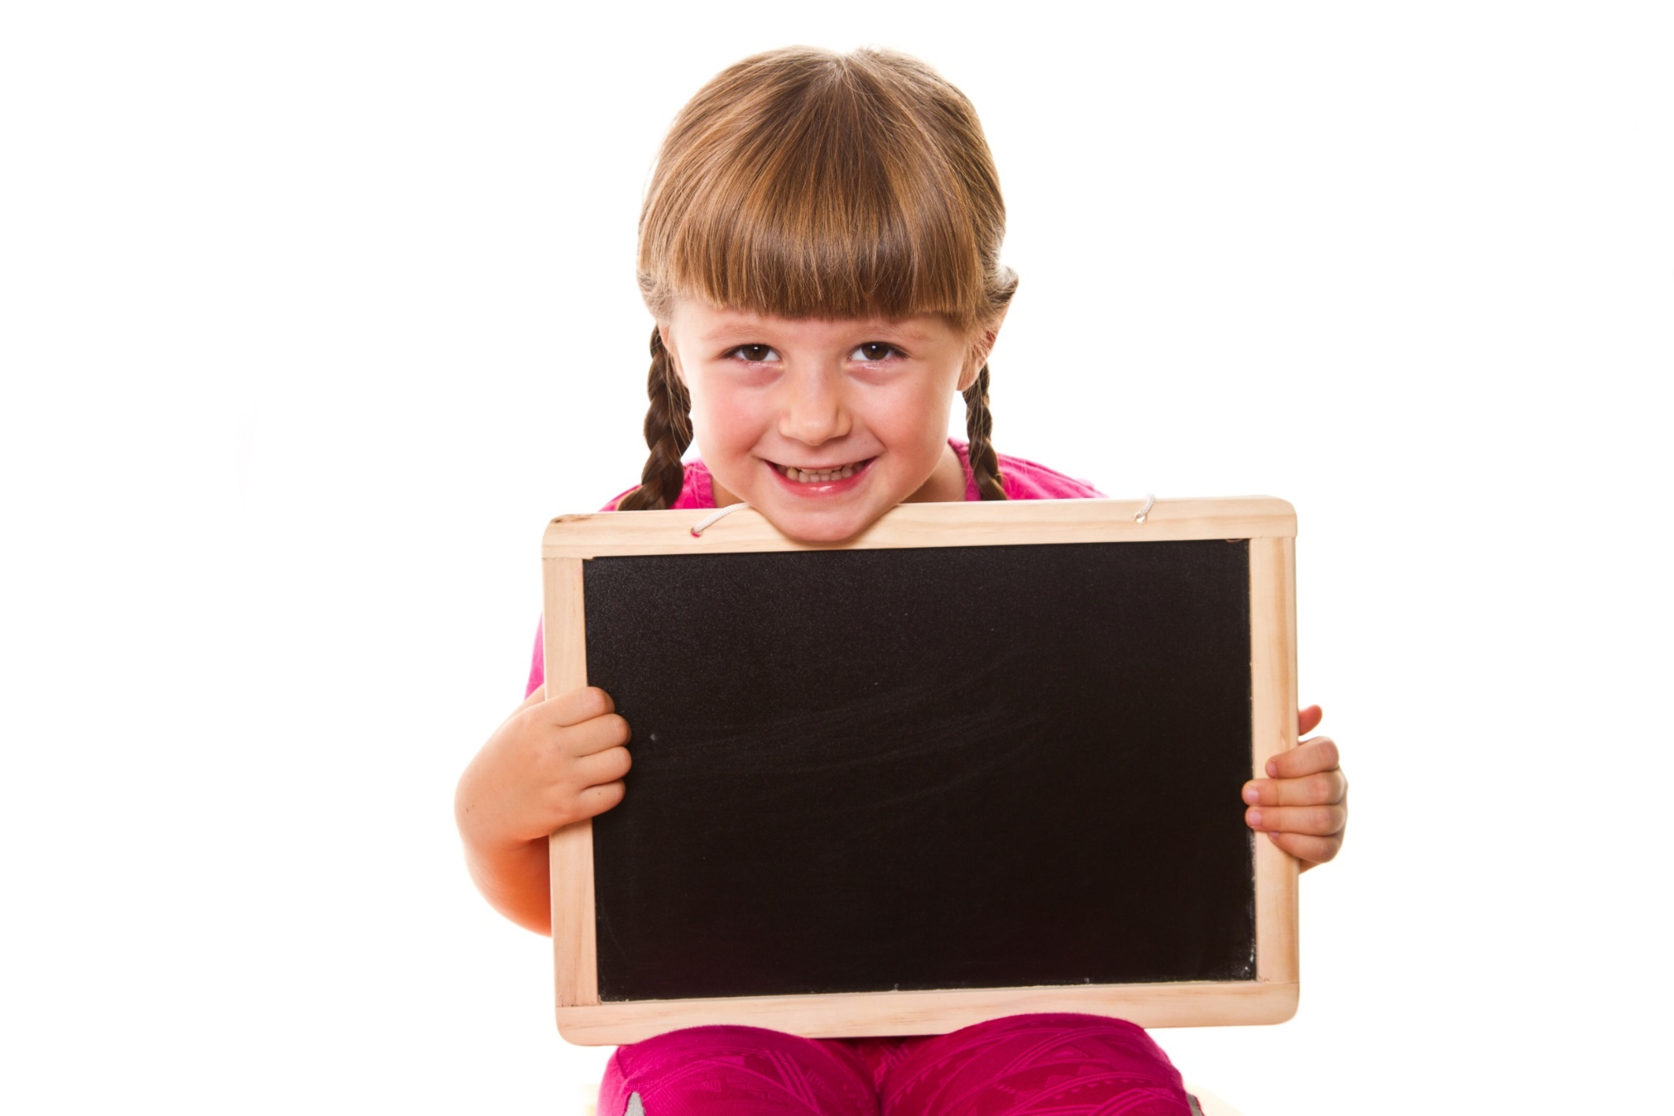
Pre-reading

Slide 6
Work in pairs. What can you see in each picture?

Slide 7
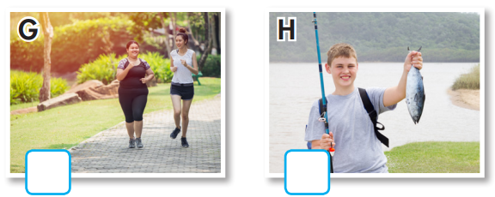
a. Number the pictures.
1. chat
2. fishing
3. hang out
4. jogging
5. jewelry
6. handball
7. rock climbing
8. board games
3
5
7
6
8
4
2

Slide 8
Listen and repeat. Click on each phrase to hear the sound.
chat (v) /tʃæt/ trò chuyện, tán gẫu
fishing (n) /ˈfɪʃɪŋ/ câu cá
hang out (v phr) /hæŋ aʊt/ gặp gỡ bạn bè, đi chơi
jogging (n) /ˈdʒɑːɡɪŋ/ (hoạt động) chạy bộ nhẹ
jewelry (n) /ˈdʒuːəlri/ đồ trang sức
handball (n) /ˈhændbɔːl/ (môn thể thao) bóng ném
rock climbing (n phr) /ˈrɑːk klaɪmɪŋ/ (môn thể thao) leo núi đá
board games (n phr) /ˈbɔːrd ɡeɪm/ trò chơi có bàn cờ
Notes:
GV click vào từng cụm nghe âm thanh

Slide 9
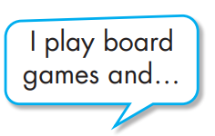
b. Write the new words into the table and add more words you know. Which activities do you do?
rock climbing
jewelry
jewelry
hang out
handball
jogging
chat online
fishing

Slide 10
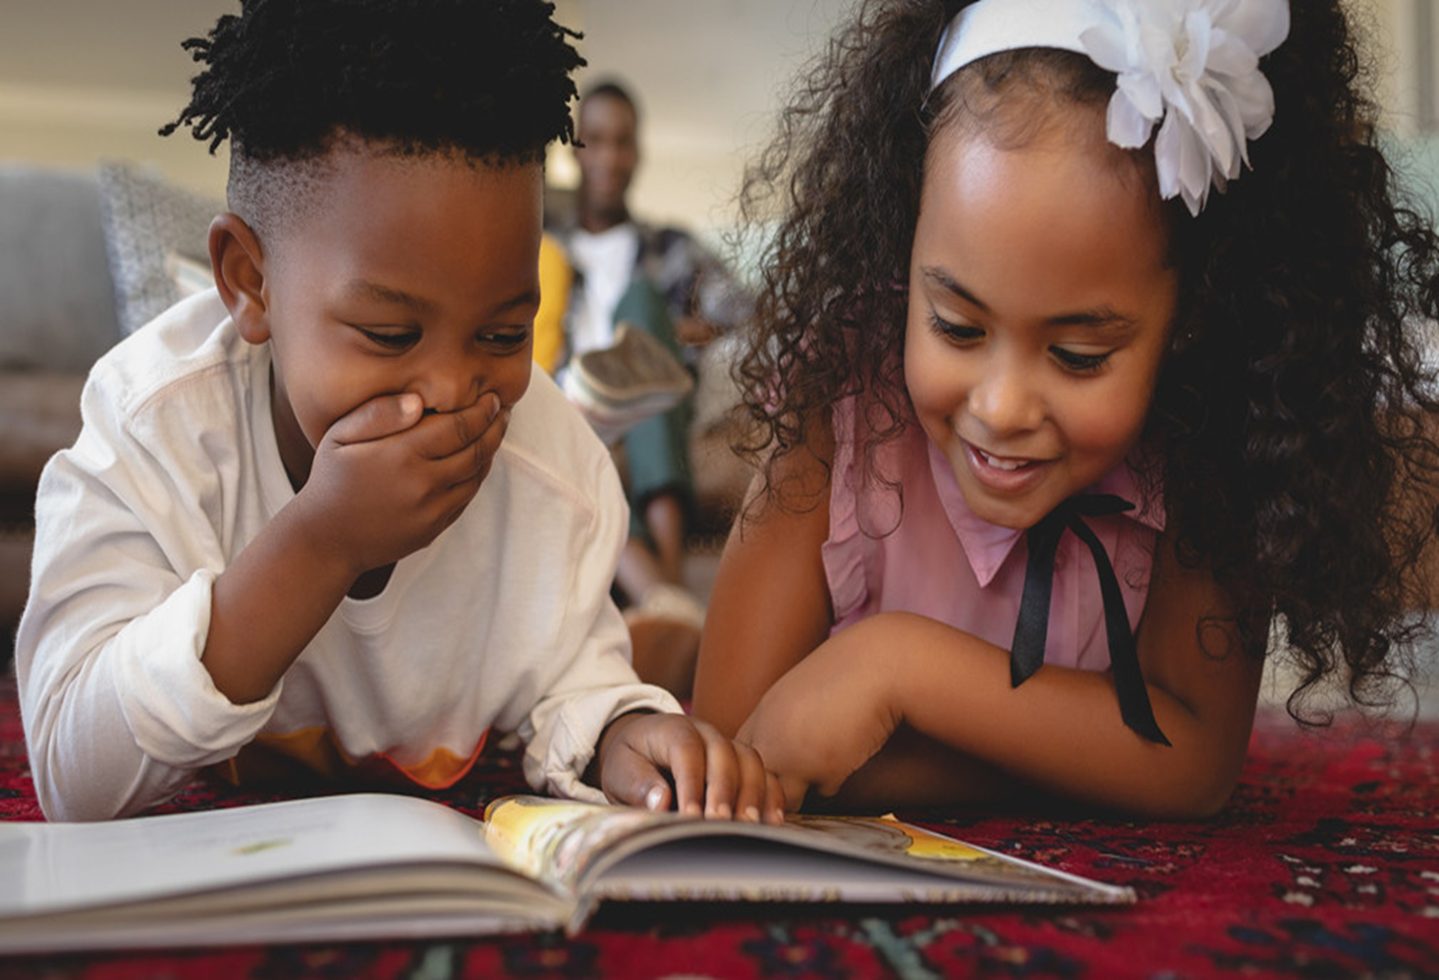

Slide 11
Pre - reading
Pair work: Name some indoor activities you know.
Reading books
Cooking
Drawing
Playing chess
Playing board games
Surfing the internet
Watching TV
Playing computer games

Slide 12
Task a
Read the instruction and the answers quickly:
Underline the key words.
What are we going to do?
Read and circle the person who prefers indoor activities.
a. Read the passages. Circle the name of the person who prefers indoor activities.
Will Jess Peter

Slide 13
While-reading

Slide 14
While - reading
Scan the text. Underline the activities each person prefers doing. Choose the correct name.
My name's Will. I love playing sports and hanging out with my friends. We love playing handball and soccer together. I think they're really exciting. I don't really like extreme sports, like skateboarding or rock climbing. They're too scary for me. I prefer safer activities, like jogging or watching TV.

Slide 15
Hello. My name's Jess. I'm not a very active person. I like reading books, chatting with my friends online, and doing arts and crafts in my bedroom. My favorite thing to do is painting. It's so relaxing. I hate playing sports and jogging. I don't think they are very fun. I prefer playing board games at home.
Hi. I'm Peter. I love doing lots of different activities. I like playing tennis with friends and I love rock climbing. It's so much fun. I also like designing clothes and bags. I don't really enjoy playing board games though. I think they're boring. I prefer singing and dancing with my friends in my backyard.

Slide 16
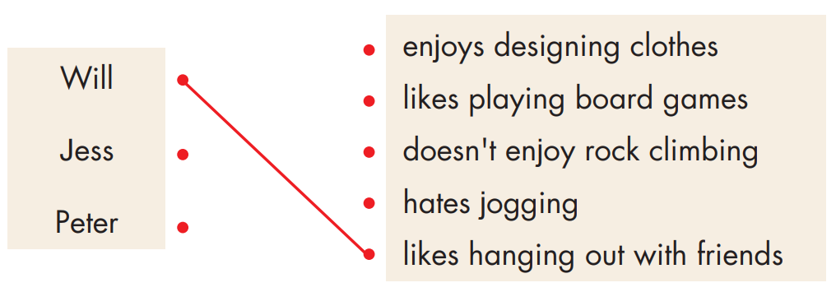
Task b
Pre-reading
Read the instruction and underline the key words.
What are we going to do?
Read and match the phrase and the person.
Read and draw lines to match the phrases and the person they describe.

Slide 17
While - reading
Scan the text. Underline the key words and match the names with the correct phrases.
My name's Will. I love playing sports and hanging out with my friends. We love playing handball and soccer together. I think they're really exciting. I don't really like extreme sports, like skateboarding or rock climbing. They're too scary for me. I prefer safer activities, like jogging or watching TV.

Slide 18
Hello. My name's Jess. I'm not a very active person. I like reading books, chatting with my friends online, and doing arts and crafts in my bedroom. My favorite thing to do is painting. It's so relaxing. I hate playing sports and jogging. I don't think they are very fun. I prefer playing board games at home.
Hi. I'm Peter. I love doing lots of different activities. I like playing tennis with friends and I love rock climbing. It's so much fun. I also like designing clothes and bags. I don't really enjoy playing board games though. I think they're boring. I prefer singing and dancing with my friends in my backyard.

Slide 19
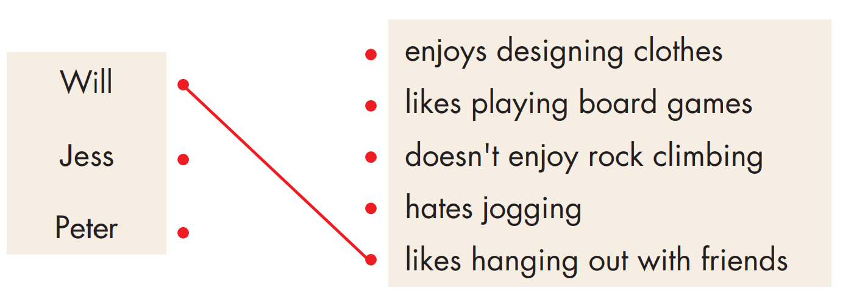
While-reading

Slide 20
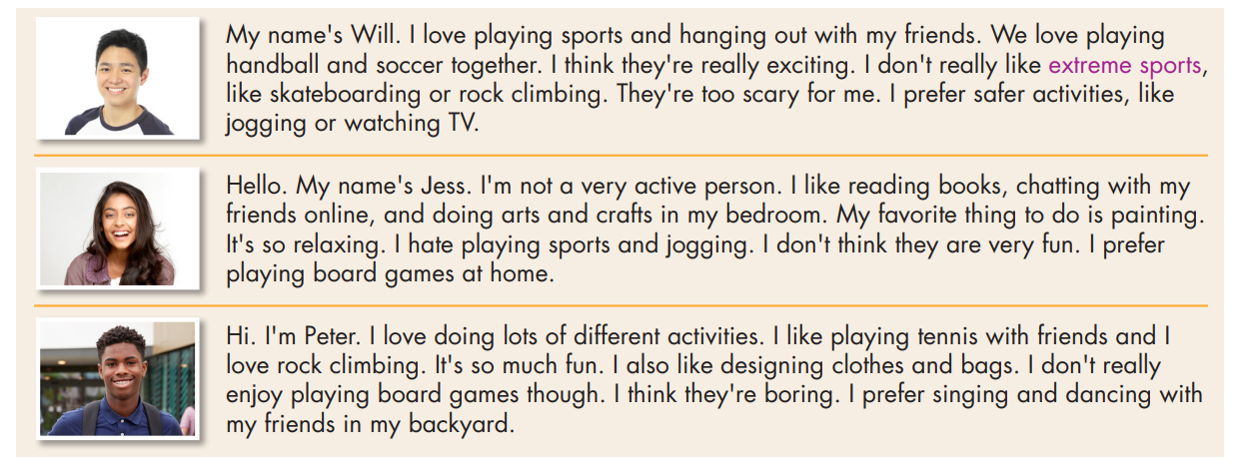
c. Listen and read.

Slide 21
Post-reading

Slide 22
Post - reading
Work in pairs
Which person are you most like? How are you similar? How are you different?
I'm most like Jess. I also like reading books, but I don't like playing board games.

Slide 23
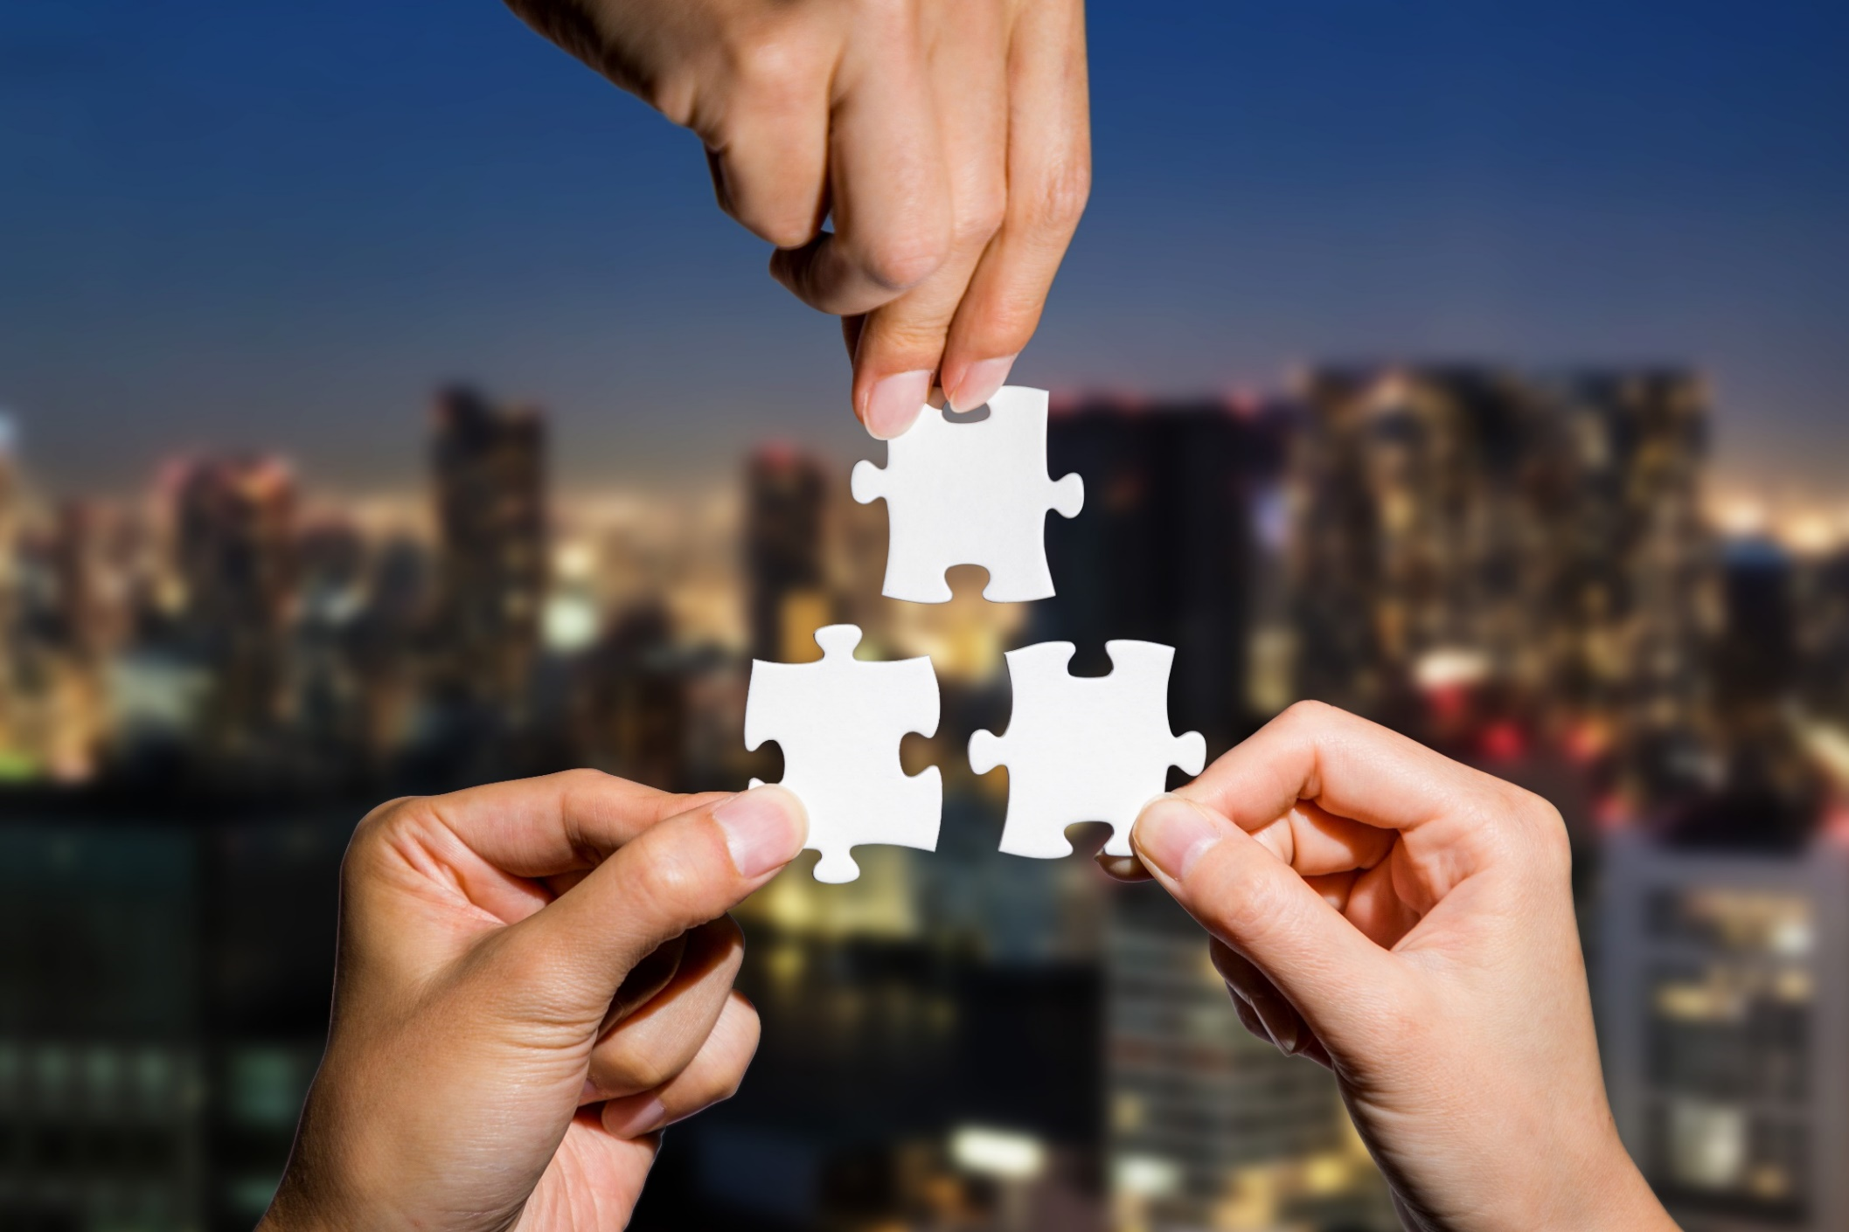
CONSOLIDATION

Slide 24
Talk to your partner about what teenagers like doing in their free time.

Slide 25
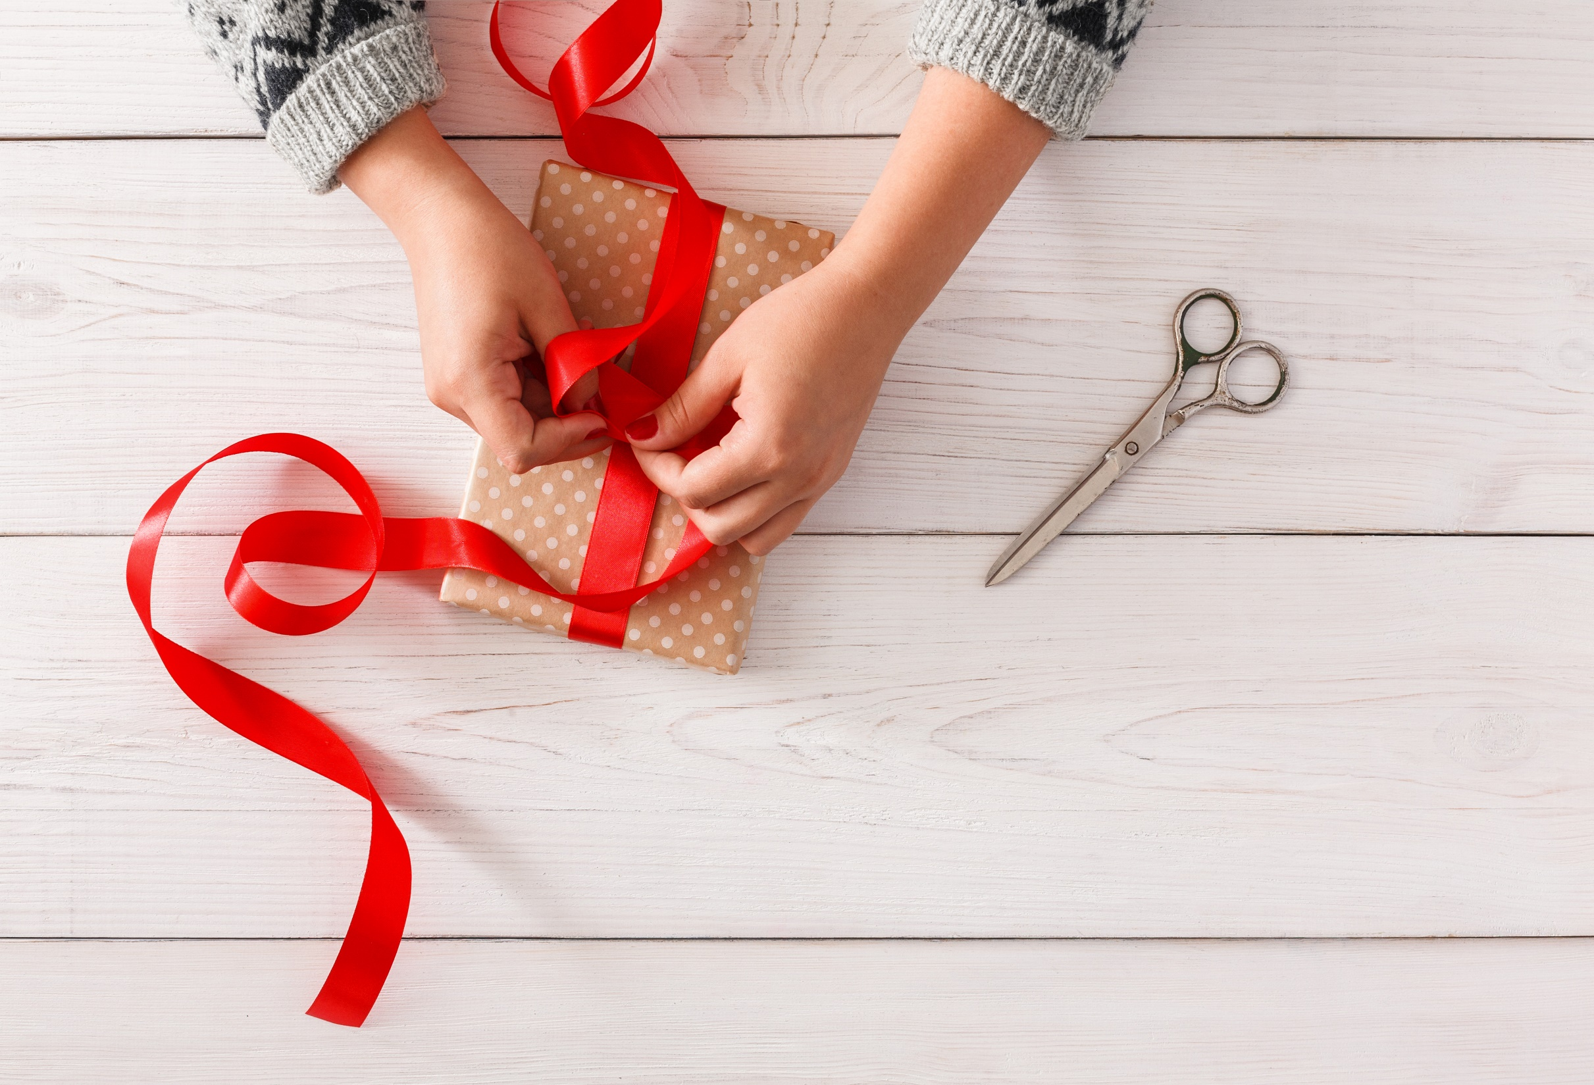
WRAP-UP

Slide 26
Today’s lesson
Vocabularies
1. chat
2. fishing
3. hang out
4. jogging
5. jewelry
6. handball
7. rock climbing
8. board games

Slide 27
Today’s lesson
Reading:
- Understanding instructions
Scanning for specific information
Speaking:
- Talking about hobbies

Slide 28
Homework
Learn by hearts vocab. and make sentences using them.
Do the vocab. and reading exercises on pages 2 & 3 WB.
Do the exercises in Tiếng Anh 8 i-Learn Smart World Notebook on pages 4 & 5.
Prepare the next lesson (pages 5 & 6 SB).
Play the consolidation games on www.eduhome.com.vn

Slide 29
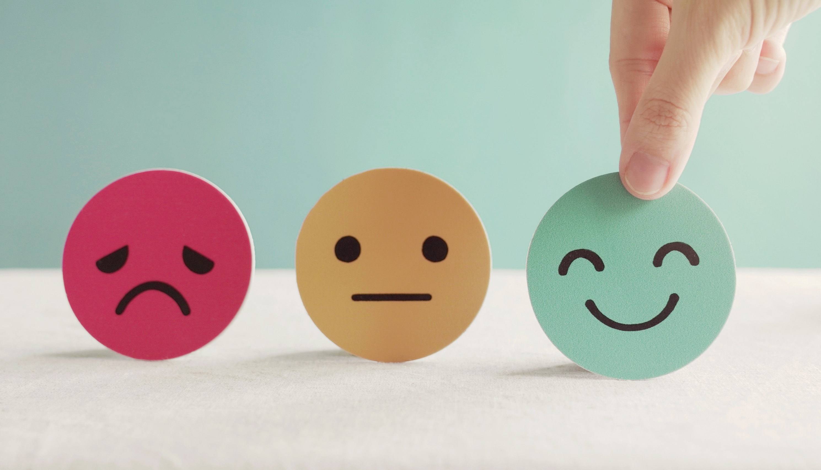
Lesson 3
Stay positive and have a nice day!

