Slide 1

Unit 2: Life In The Country
Lesson 1.2: Grammar
Pages 15 & 16

Slide 2
Lesson Outline
Warm-up
Grammar
Consolidation
Wrap-up

Slide 3

By the end of this lesson, students will be able to…
- practice and use quantifiers with countable and uncountable nouns correctly .

Slide 4

WARM UP

Slide 5
Work in pairs.
Put the words below in the correct column: countable and uncountable nouns.
Air, noise, facility, vehicle, pollution, entertainment, transportation, people, nature, peace, thing, car.
Un Countable nouns | countable nouns
air, noise, pollution, entertainment, peace transportation, nature,
facility, vehicle, people, thing, car

Slide 6

Presentation

Slide 7
Underline quantifiers and circle the nouns after them
1. There are lots of people.
2. There is too much work to do.
3. There are too many cars on the road.
4. There isn't enough time to play.

Slide 8
Complete the rules with lots of/ a lot of, not enough, are too many, is too much
………………………….means a large amount of something.
………………………….means the amount of something countable is more than you want.
………………………….means the amount of something uncountable is more than you want.
………………………….means the amount is less than you want.
lots of/a lot of
are too many
is too much
not enough
Note: too many, too much, not enough have a negative meaning.

Slide 9
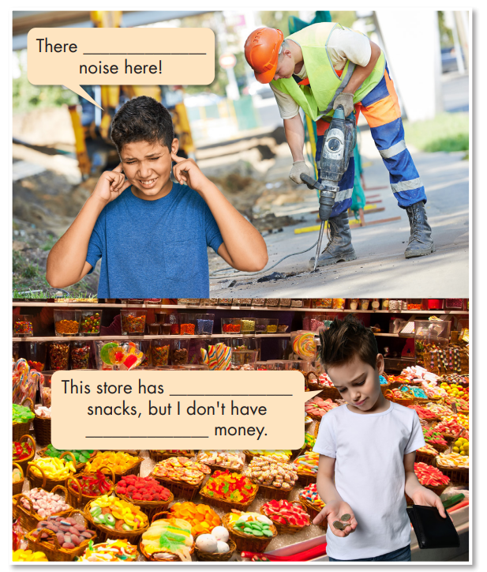

Fill in the blanks.
is too much
Listen and check your answers.
Listen again and repeat.
lots of
enough

Slide 10
Practice

Slide 11
Task a
Read the examples on the left and circle the
correct words.
1. There are too much/many vehicles on the road.
2. There aren't/isn't enough facilities in this village.
3. There is/are too much noise in my town.
4. This city doesn't have enough/many fresh air.
5. There isn't enough things to do/entertainment here.
6. There is lots of nature/vehicles here in the country.

Slide 12
Task b
Write sentences using the prompts.
1. There/lots/peace and quiet/my village
_____________________________________________
2. My town/not/have/enough/entertainment
_____________________________________________
3. This city/have/much/pollution
_____________________________________________
4. There/many/vehicles/my street
_____________________________________________
5. There/lot/room/people/play/my city
_____________________________________________
6. There/not/many/things/do/my village
_____________________________________________
There is lots of peace and quiet in my village.
My town doesn't have enough entertainment.
This city has too much pollution.
There are too many vehicles in/on my street.
There is a lot of room for people to play in my city.
There aren't many things to do in my village.

Slide 13
Extra practice
Grammar exercise page 9 WB
Write sentences using the prompts.
1. too/many/car/bus/my/city
______________________________________________
2. not/enough/thing/do/country
______________________________________________
3. lots/public/transportation/Castleford
______________________________________________
4. not/much/noise/Shine Village
______________________________________________
5. too/much/pollution/my city
______________________________________________
6. too/many/vehicle/city center
______________________________________________
There are too many cars and buses in my city.
There aren't enough things to do in the country.
There's lots of public transportation in Castleford.
There isn't much noise in Shine Village.
There's too much pollution in my city.
There are too many vehicles in the city center.

Slide 14
Production

Slide 15

Task c
Work in pairs
Talk about your town using lots of/a lot of, not enough, too many, and too much.
There are lots of vehicles in my hometown.
My city has too much
noise.

Slide 16

CONSOLIDATION

Slide 17
Write four sentences about your town/city using lots of/ a lot of, not enough, too many, too much.
Example:
There is lots of pollution in my city.
There is not enough fresh air.
There are too many vehicles.
There is too much noise during rush hours.

Slide 18

WRAP-UP

Slide 19
Today’s lesson
Grammar
quantifiers with countable and uncountable nouns
Speaking
Talking about life in the city and in the country.

Slide 20
Homework
Learn by hearts the grammar point and make sentences using it.
Do the exercises in Tiếng Anh 8 i-Learn Smart World Notebook on page 14.
Prepare the next lesson (pages 16 & 17 SB)
Play the consolidation games on www.eduhome.com.vn

Slide 21

Lesson 3
Stay positive and have a nice day!

