Slide 1
Unit 2: Life in the Country
Review: Listening & Reading
Page 86

Slide 2
Lesson Outline
Warm-up
Listening
Reading
Consolidation
Wrap-up

Slide 3
By the end of this lesson, students will be able to…
- review the target language learnt in the unit
- practice test taking skills

Slide 4
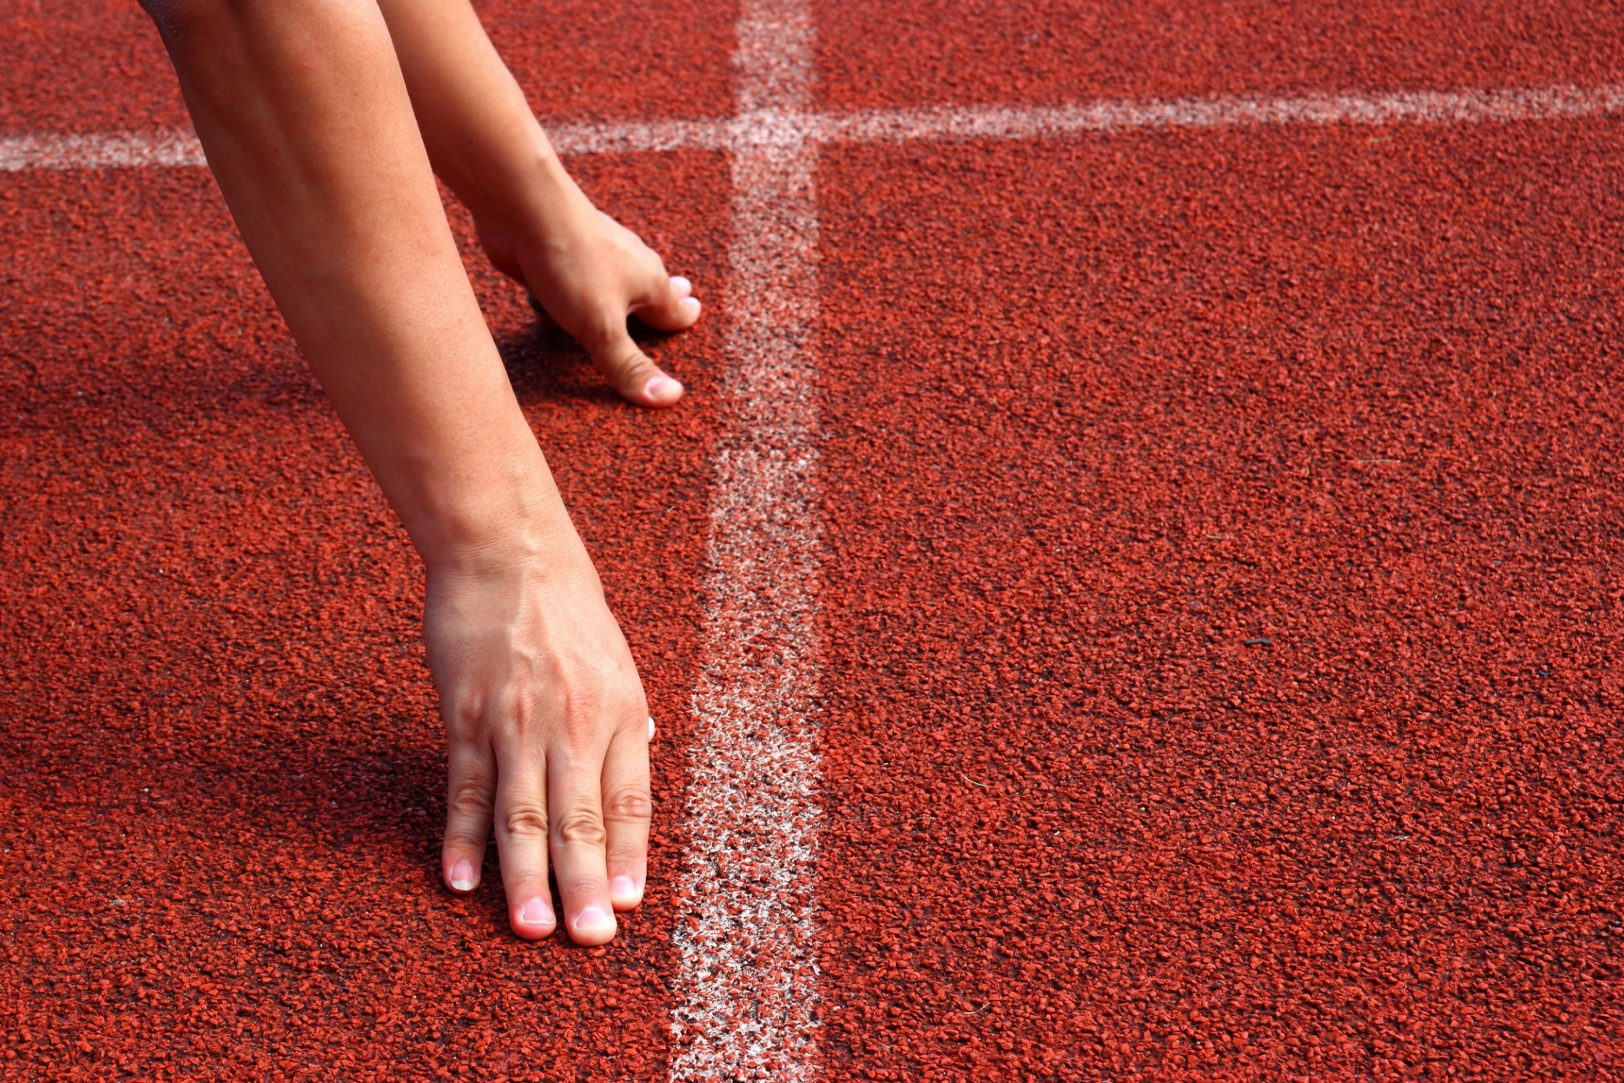
WARM UP

Slide 5
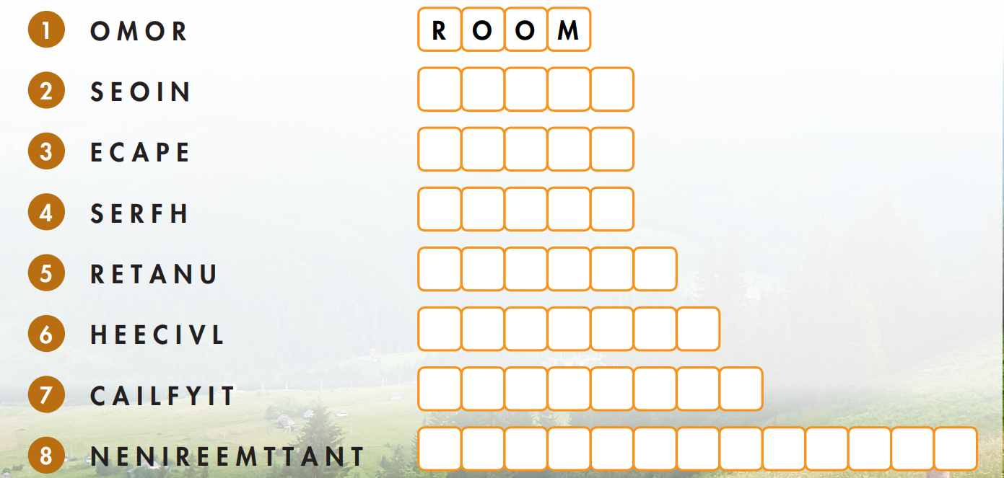
Unscramble the words.
N
O
I
S
E
P
E
A
C
E
F
R
E
S
H
N
A
T
U
R
E
V
E
H
I
C
L
E
F
A
C
I
L
I
T
Y
E
N
T
E
R
T
A
I
N
M
E
N
T

Slide 6
Listening

Slide 7
Pre-listening
Read the instructions, underline the key words and say what you are going to do.
You will hear two students talking about country and city life. Listen and fill in the blanks. You will hear the information twice.
Listen to two students talking about country and city life and fill in the blanks.

Slide 8
Look at the notes and underline the key words.

Slide 9
While-listening
Listen and fill in the blanks.
cafes
fresh air
vehicles
room
schools

Slide 10
Listen and fill in the blanks.
bad
Rob: We need to plan our presentation on city and country life, Jessica.
Jessica: I know, I know. Let’s do it.
Rob: OK. What are some …………… things about living in the city?
Jessica: There are lots of ………………… and malls. There are so many things to do.
Rob: Yeah, that’s a good idea.
Jessica: I also like the ……………….
Rob: Me too. What about the country?
Jessica: Well…there’s lots of ………………. There’s more fresh air, too.
Rob: You’re right. Much more than the city.
Jessica: Yeah.
Rob: OK. What about ……….. things about the city?
Jessica: That’s easy. There are too many vehicles.
Rob: Yeah, there are.
Jessica: What else?
Rob: There isn’t enough room.
Jessica: I agree. There aren’t many ………………. or places to run around.
Rob: OK. And the country?
Jessica: There are too many ………………. I’m scared of snakes and so many other animals.
Rob: Hmm. OK. I like all the animals in the country. I think we should write that there aren’t enough ………………….
Jessica: That’s a good idea. Let’s write that.
good
museums
parks
cafes
animals
nature
schools

Slide 11
Reading

Slide 12
Pre-reading
Read the instructions, underline the key words and say what you are going to do.
Look and read. Choose the correct answer (A, B, or C).
Look and read. Choose the correct answer (A, B, or C).

Slide 13
Look at the questions and underline the key words.
0. Where does Tâm live?
1. What is Tâm good at?
2. What does Tâm like to do more than to play shuttlecock?
3. What activity does Tâm's brother not like to do?
4. What does Tâm's family like to do together?

Slide 14
While-reading
Read and choose the correct answer (A, B, or C).
0. Where does Tâm live?
B. Di Linh
Hello. My name is Tâm, and I live in Di Linh, Vietnam. It's about 230 kilometers away from Ho Chi Minh City.
I really like to play and have fun with my friends. I love to play spinning tops. I think it's a really fun game. I also like to play tug of war. I'm strong, so I'm really good at it. My friends often play shuttlecock. I don't really like it. I think it's boring. I prefer to jump rope or go to my folk dance class. I dance with my sister every Sunday. We're not very good at it, but we always have a good time when we dance. My brother doesn't really like to dance. He usually picks flowers or makes jewelry. My family likes to play board games together. We sometimes play after dinner or before bed.
I want to learn some more folk games and teach them to my friends and family. I think they'll like it.

Slide 15
1. What is Tâm good at?
A. Tug of war
Hello. My name is Tâm, and I live in Di Linh, Vietnam. It's about 230 kilometers away from Ho Chi Minh City.
I really like to play and have fun with my friends. I love to play spinning tops. I think it's a really fun game. I also like to play tug of war. I'm strong, so I'm really good at it. My friends often play shuttlecock. I don't really like it. I think it's boring. I prefer to jump rope or go to my folk dance class. I dance with my sister every Sunday. We're not very good at it, but we always have a good time when we dance. My brother doesn't really like to dance. He usually picks flowers or makes jewelry. My family likes to play board games together. We sometimes play after dinner or before bed.
I want to learn some more folk games and teach them to my friends and family. I think they'll like it.

Slide 16
2. What does Tâm like to do more than to play shuttlecock?
C. jump rope
Hello. My name is Tâm, and I live in Di Linh, Vietnam. It's about 230 kilometers away from Ho Chi Minh City.
I really like to play and have fun with my friends. I love to play spinning tops. I think it's a really fun game. I also like to play tug of war. I'm strong, so I'm really good at it. My friends often play shuttlecock. I don't really like it. I think it's boring. I prefer to jump rope or go to my folk dance class. I dance with my sister every Sunday. We're not very good at it, but we always have a good time when we dance. My brother doesn't really like to dance. He usually picks flowers or makes jewelry. My family likes to play board games together. We sometimes play after dinner or before bed.
I want to learn some more folk games and teach them to my friends and family. I think they'll like it.

Slide 17
3. What activity does Tâm's brother not like to do?
A. dance
Hello. My name is Tâm, and I live in Di Linh, Vietnam. It's about 230 kilometers away from Ho Chi Minh City.
I really like to play and have fun with my friends. I love to play spinning tops. I think it's a really fun game. I also like to play tug of war. I'm strong, so I'm really good at it. My friends often play shuttlecock. I don't really like it. I think it's boring. I prefer to jump rope or go to my folk dance class. I dance with my sister every Sunday. We're not very good at it, but we always have a good time when we dance. My brother doesn't really like to dance. He usually picks flowers or makes jewelry. My family likes to play board games together. We sometimes play after dinner or before bed.
I want to learn some more folk games and teach them to my friends and family. I think they'll like it.

Slide 18
4. What does Tâm's family like to do together?
B. play board games
Hello. My name is Tâm, and I live in Di Linh, Vietnam. It's about 230 kilometers away from Ho Chi Minh City.
I really like to play and have fun with my friends. I love to play spinning tops. I think it's a really fun game. I also like to play tug of war. I'm strong, so I'm really good at it. My friends often play shuttlecock. I don't really like it. I think it's boring. I prefer to jump rope or go to my folk dance class. I dance with my sister every Sunday. We're not very good at it, but we always have a good time when we dance. My brother doesn't really like to dance. He usually picks flowers or makes jewelry. My family likes to play board games together. We sometimes play after dinner or before bed.
I want to learn some more folk games and teach them to my friends and family. I think they'll like it.

Slide 19
Read the sentences and underline key words.
1. Tam’s hometown is about 320 kilometers away from Ho Chi Minh City.
2. Tam thinks spinning tops is a really fun game.
3. Tam always have a good time when he dances with his sister.
4. Tam’s brother never picks flowers or makes jewelry.
5. Tam’s family sometimes play board games before dinner.

Slide 20
1. Tam’s hometown is about 320 kilometers away from Ho Chi Minh City.
F
Hello. My name is Tâm, and I live in Di Linh, Vietnam. It's about 230 kilometers away from Ho Chi Minh City.
I really like to play and have fun with my friends. I love to play spinning tops. I think it's a really fun game. I also like to play tug of war. I'm strong, so I'm really good at it. My friends often play shuttlecock. I don't really like it. I think it's boring. I prefer to jump rope or go to my folk dance class. I dance with my sister every Sunday. We're not very good at it, but we always have a good time when we dance. My brother doesn't really like to dance. He usually picks flowers or makes jewelry. My family likes to play board games together. We sometimes play after dinner or before bed.
I want to learn some more folk games and teach them to my friends and family. I think they'll like it.

Slide 21
2. Tam thinks spinning tops is a really fun game.
T
Hello. My name is Tâm, and I live in Di Linh, Vietnam. It's about 230 kilometers away from Ho Chi Minh City.
I really like to play and have fun with my friends. I love to play spinning tops. I think it's a really fun game. I also like to play tug of war. I'm strong, so I'm really good at it. My friends often play shuttlecock. I don't really like it. I think it's boring. I prefer to jump rope or go to my folk dance class. I dance with my sister every Sunday. We're not very good at it, but we always have a good time when we dance. My brother doesn't really like to dance. He usually picks flowers or makes jewelry. My family likes to play board games together. We sometimes play after dinner or before bed.
I want to learn some more folk games and teach them to my friends and family. I think they'll like it.

Slide 22
3. Tam always have a good time when he dances with his sister.
T
Hello. My name is Tâm, and I live in Di Linh, Vietnam. It's about 230 kilometers away from Ho Chi Minh City.
I really like to play and have fun with my friends. I love to play spinning tops. I think it's a really fun game. I also like to play tug of war. I'm strong, so I'm really good at it. My friends often play shuttlecock. I don't really like it. I think it's boring. I prefer to jump rope or go to my folk dance class. I dance with my sister every Sunday. We're not very good at it, but we always have a good time when we dance. My brother doesn't really like to dance. He usually picks flowers or makes jewelry. My family likes to play board games together. We sometimes play after dinner or before bed.
I want to learn some more folk games and teach them to my friends and family. I think they'll like it.

Slide 23
4. Tam’s brother never picks flowers or makes jewelry.
F
Hello. My name is Tâm, and I live in Di Linh, Vietnam. It's about 230 kilometers away from Ho Chi Minh City.
I really like to play and have fun with my friends. I love to play spinning tops. I think it's a really fun game. I also like to play tug of war. I'm strong, so I'm really good at it. My friends often play shuttlecock. I don't really like it. I think it's boring. I prefer to jump rope or go to my folk dance class. I dance with my sister every Sunday. We're not very good at it, but we always have a good time when we dance. My brother doesn't really like to dance. He usually picks flowers or makes jewelry. My family likes to play board games together. We sometimes play after dinner or before bed.
I want to learn some more folk games and teach them to my friends and family. I think they'll like it.

Slide 24
5. Tam’s family sometimes play board games before dinner.
F
Hello. My name is Tâm, and I live in Di Linh, Vietnam. It's about 230 kilometers away from Ho Chi Minh City.
I really like to play and have fun with my friends. I love to play spinning tops. I think it's a really fun game. I also like to play tug of war. I'm strong, so I'm really good at it. My friends often play shuttlecock. I don't really like it. I think it's boring. I prefer to jump rope or go to my folk dance class. I dance with my sister every Sunday. We're not very good at it, but we always have a good time when we dance. My brother doesn't really like to dance. He usually picks flowers or makes jewelry. My family likes to play board games together. We sometimes play after dinner or before bed.
I want to learn some more folk games and teach them to my friends and family. I think they'll like it.

Slide 25
Post-reading
In pairs: tell your partner who you usually spend your free time with (friends or family) and what you usually do with them.
I usually spend my free time with my best friends. We usually play basketball together after school.
I usually spend my free time with my family. We usually have a picnic in the park on the weekends.

Slide 26
CONSOLIDATION

Slide 27
Write four sentences about what children in your hometown usually do with their family and friends in their free time.
For example:
Children in my hometown spend more time with their friends because their parents are busy with their work. They usually play folk games like tug of war, hide and seek or jumping rope. Sometimes, they play marbles or go fishing. In the evening, they usually watch TV with their parents while having dinner.

Slide 28
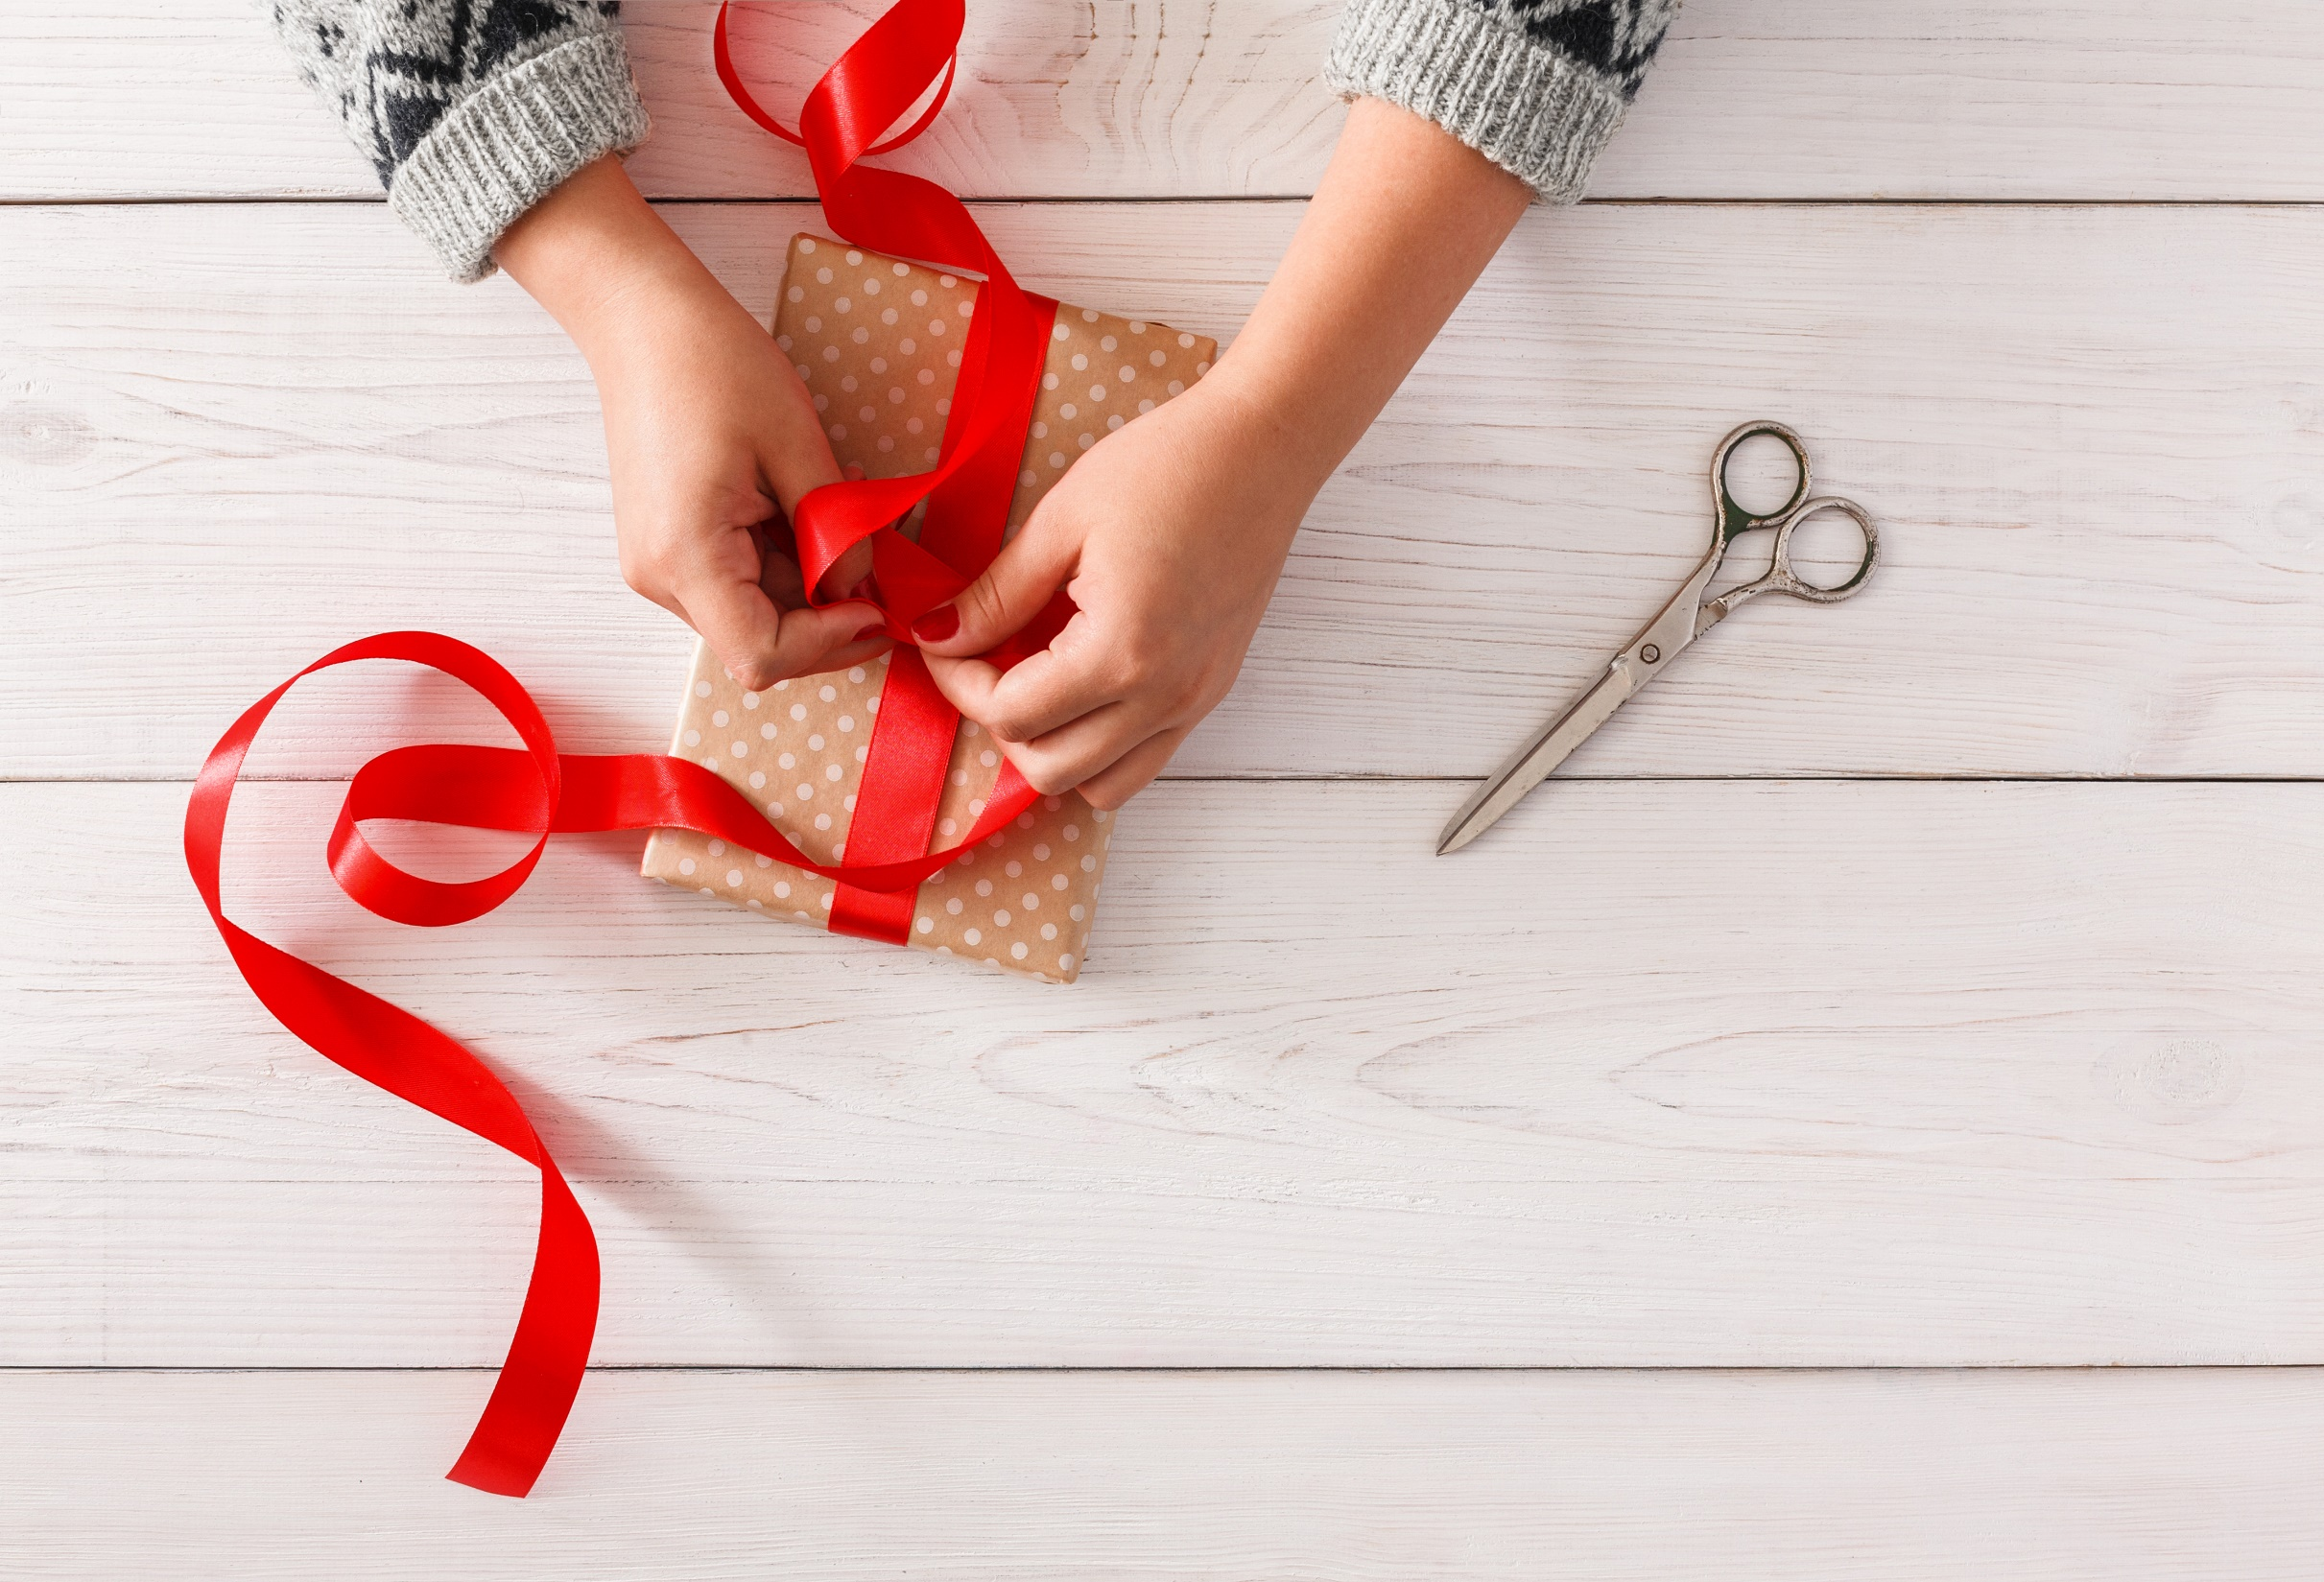
WRAP-UP

Slide 29
Today’s lesson
Listening
Listen to a conversation about life in the country and the city.
Reading
Read a passage about leisure activities in the country.

Slide 30
Homework
Do the exercises on page 51 WB.
Review the vocab and grammar in the unit. Practice using them.
Prepare the next lesson (page 87 SB)
Play the consolidation games on www.eduhome.com.vn

Slide 31
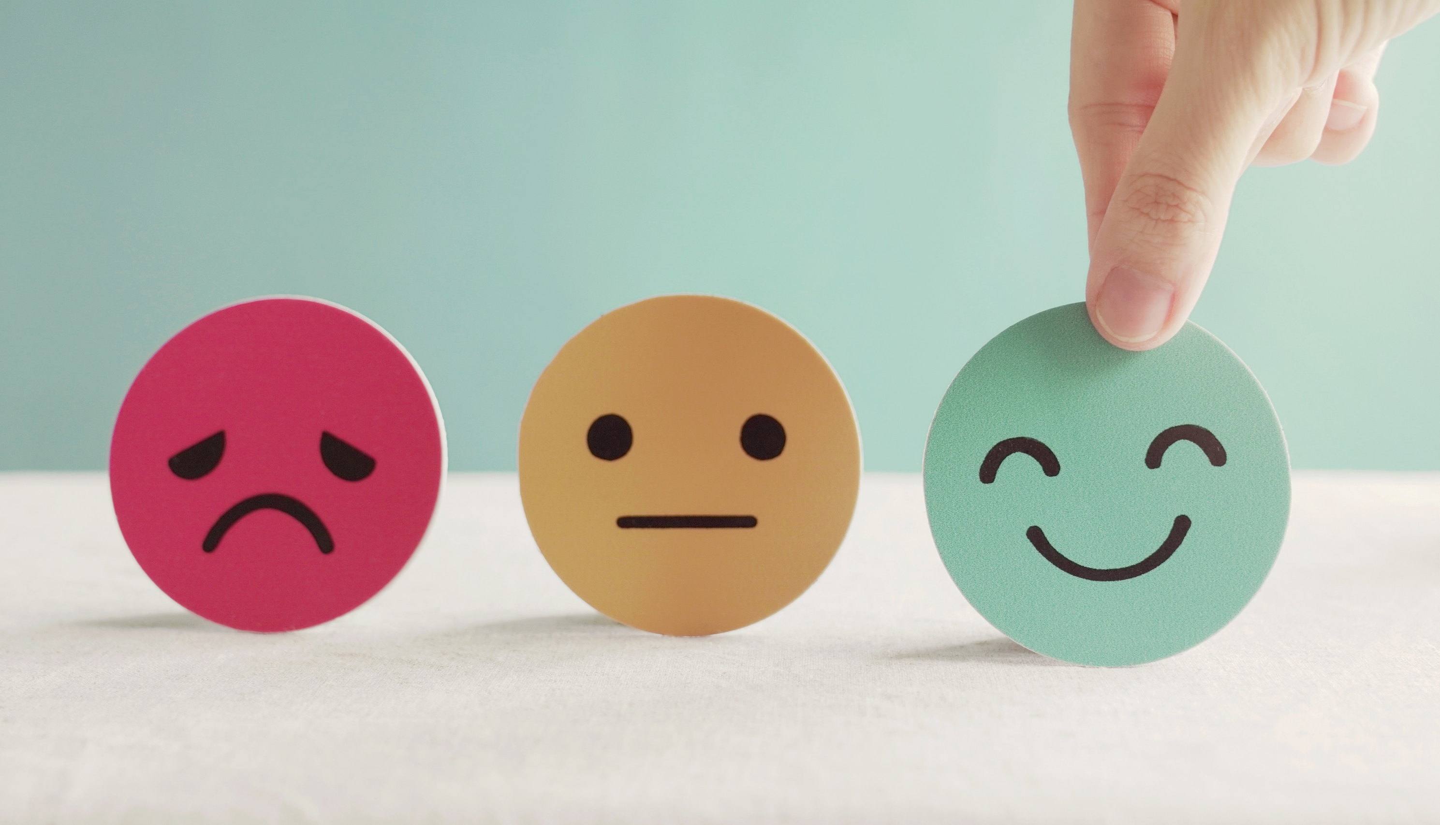
Lesson 3
Stay positive and have a nice day!

