Slide 1

Unit 3:
Protecting the Environment
Lesson 3.2 – Speaking & Writing
Page 33

Slide 2
Lesson Outline
Warm-up
Speaking
Writing
Consolidation
Wrap-up

Slide 3

By the end of this lesson, students will be able to…
- talk about ways to protect the environment.
- write a guide to make their school greener.

Slide 4

WARM UP

Slide 5
Match
If they keep polluting the river,
If they keep burning trash,
If they continue cutting down trees,
there will have no trees.
all the fish will die.
the air will be polluted.
Make more sentences using First Conditional.

Slide 6

Pre-writing

Slide 7
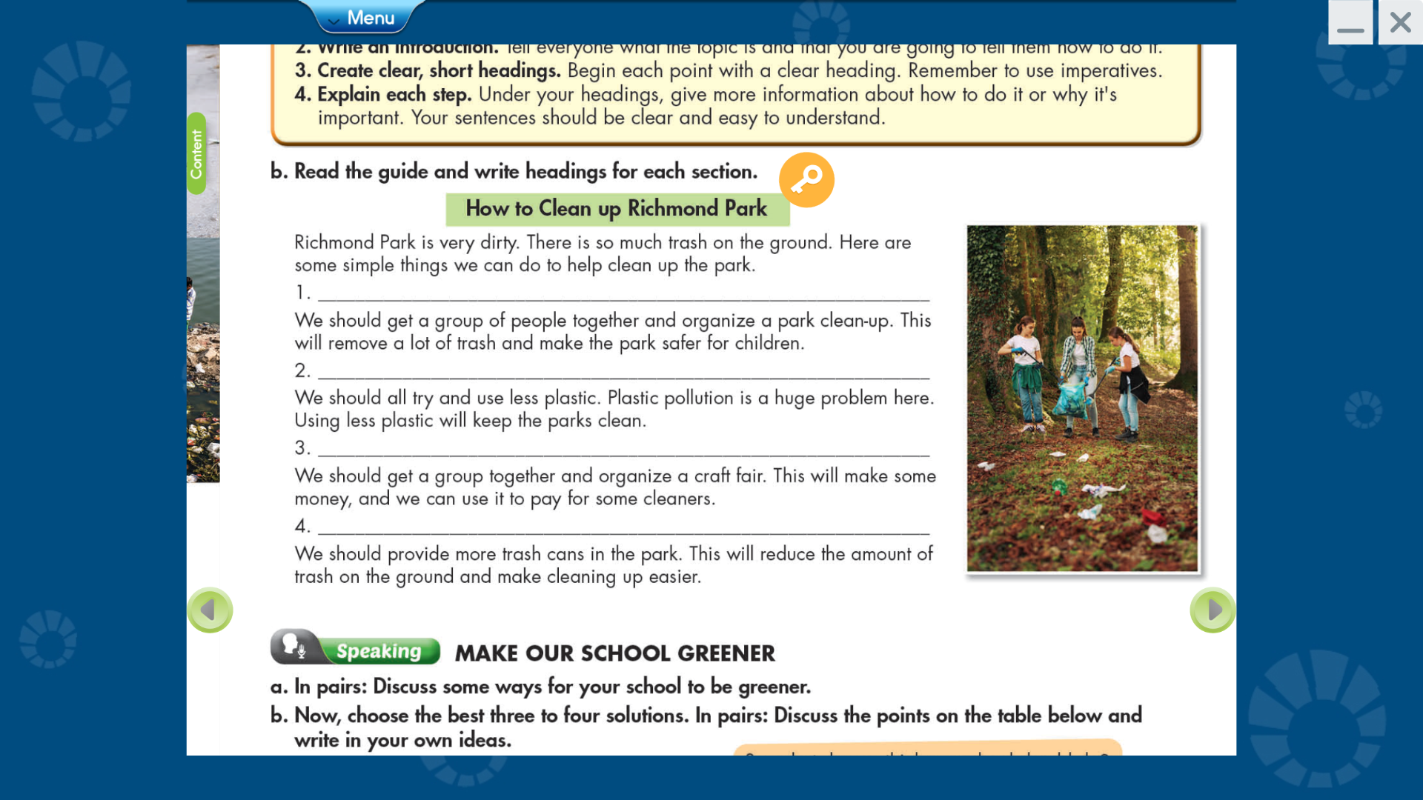

Slide 8
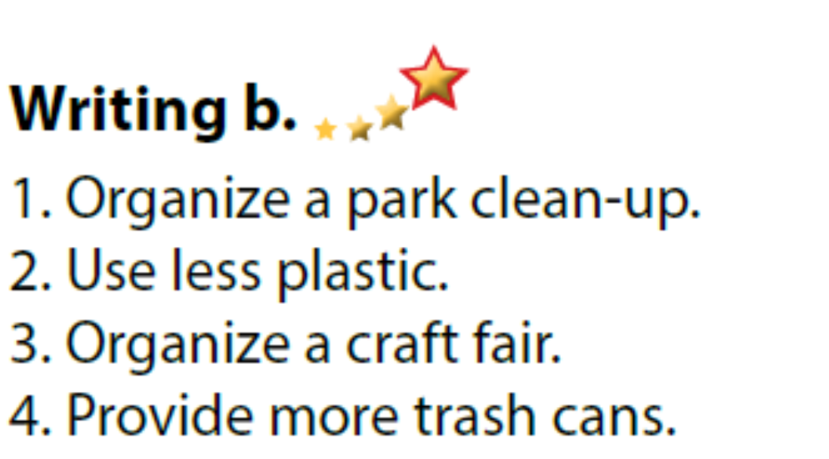

Slide 9
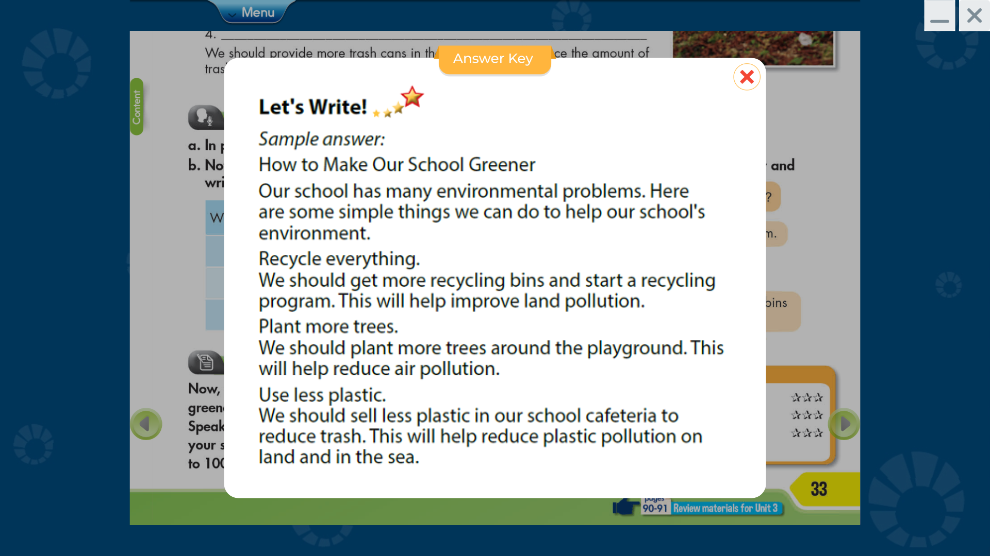

Slide 10
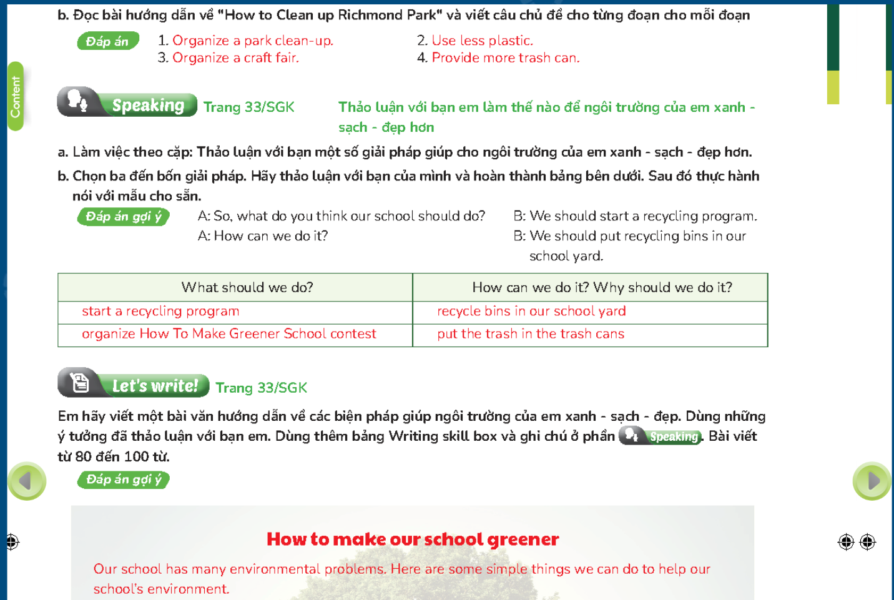

Slide 11
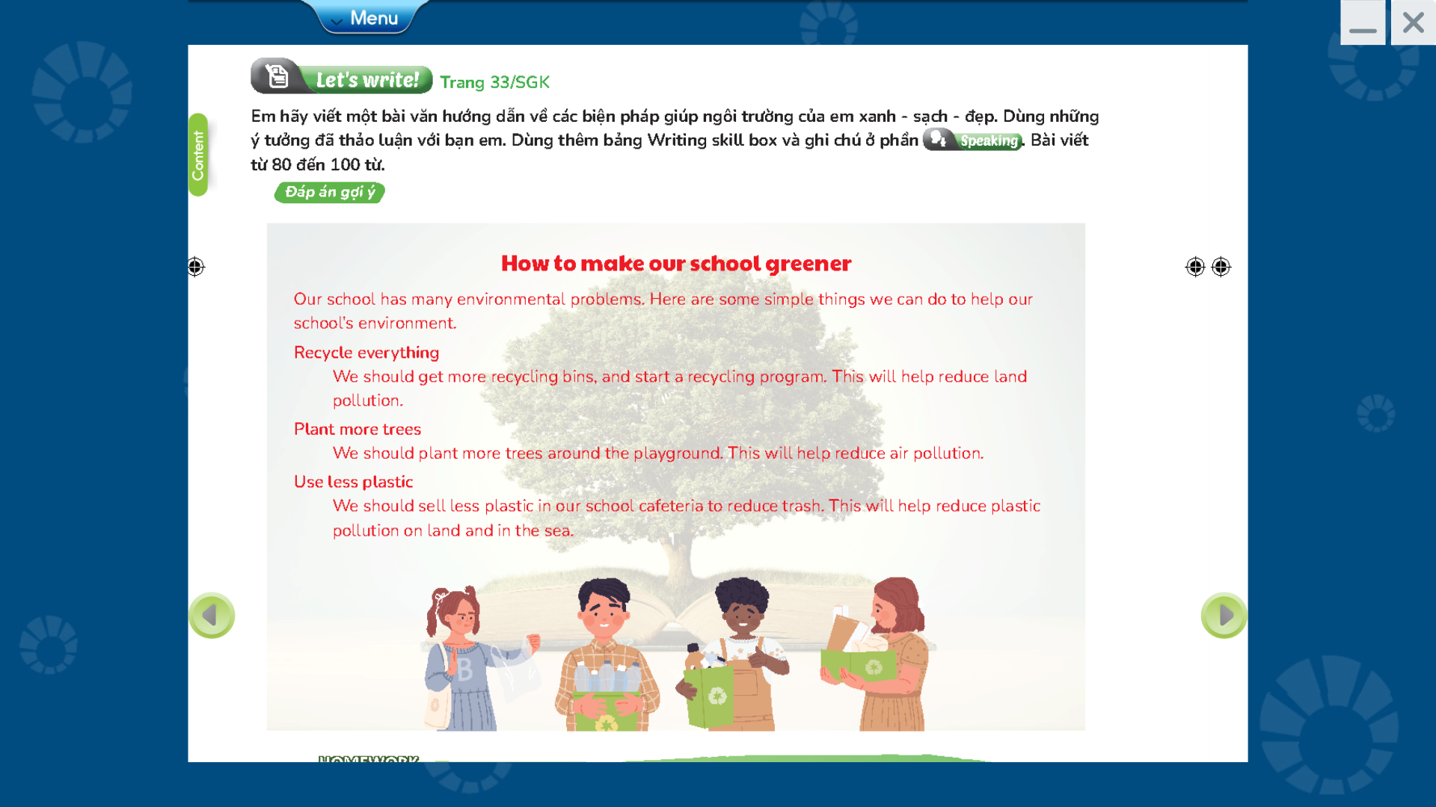

Slide 12


Work in pairs
Discuss some ways for your school to be greener.

Slide 13

Work in pairs
So, what do you think our school should do?
We should start a recycling program.
How can we do it?
We should put recycling bins in our school yard.

Slide 14
Share in front of classroom.
So, what do you think our school should do?
We should start a recycling program.
How can we do it?
We should put recycling bins in our school yard.

Slide 15

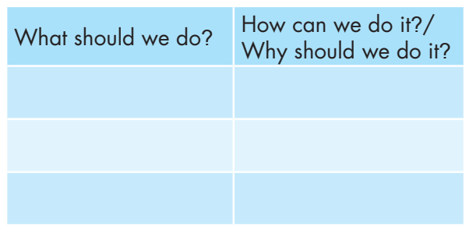
Now, choose the best three to four solution.
In pairs: Discuss the points on the table below and write your own idea.

Slide 16

While-Writing

Slide 17

Now, write a guide to make your school greener using the idea you discussed in Speaking. Use the Writing Skill box and your speaking notes to help you. Write 80 to 100 words.

Slide 18
Writing guides: To write a good, simple guide, you should:
Create a title. Tell everyone what this guide is for.
Write an introduction. Tell everyone what topic is and that you are going to tell them how to do it.
Create clear, short headings. Begin each point with a clear heading. Remember to use imperatives.
Explain each step. Under your headings, give more information about how to do it or why it’s important. Your sentences should be clear and easy to understand.

Slide 19
Can you remember?
What is a structure of a guide?
How many sections are there in a guide?
Which part do we have to use imperatives?
What do you write in a title and introduction?

Slide 20
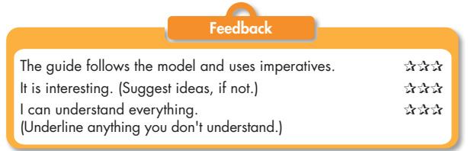
Write a guide.
Check your answers with a partner, using the feedback form.

Slide 21

Post-writing

Slide 22
You will have your passages assessed thanks to these criteria:
• a guide structure
• interesting ideas
• sentence fluency
• word choice
• spelling and punctuation
• easy to understand

Slide 23
How to Make Our School Greener
Our school has many environmental problems. Here
are some simple things we can do to help our school's
environment.
Recycle everything.
We should get more recycling bins and start a recycling
program. This will help improve land pollution.
Plant more trees.
We should plant more trees around the playground. This will help reduce air pollution.
Use less plastic.
We should sell less plastic in our school cafeteria to
reduce trash. This will help reduce plastic pollution on
land and in the sea.
Suggested writing

Slide 24

CONSOLIDATION

Slide 25
How to write a guide?
A guide
Title
What is a guide for.
Introduction
Should be clear and easy to understand.
Headings
Explain
What the topic is.
What to tell about.
Should be clear, short.
Use the imperatives.

Slide 26

WRAP-UP

Slide 27
Today’s lesson
Speaking: discuss some ways for your school to be greener.
Writing: How to write a guide.

Slide 28
Homework
- Review how to write a guide.
- Finish the writing part.
- Do the exercises in WB: Writing (page 19).
- Play consolidation games in Tiếng Anh 8 i-Learn Smart World DHA App on www.eduhome.com.vn
- Prepare: Unit 3 – Review – page 90.

Slide 29

Lesson 3
Stay positive and have a nice day!

