Slide 1
Unit 6: Life on other planets
REVIEW 1
Page 98

Slide 2
Lesson Outline
Warm-up
Listening
Reading
Consolidation
Wrap-up

Slide 3
By the end of this lesson, students will be able to…
-review vocabularies and grammar points in Unit 6.
- practice listening, reading, and speaking skills.
- practice test taking skills.

Slide 4
Lesson 1
WARM UP

Slide 5
Unscramble the sentences

Slide 6
Unscramble the sentences

Slide 7
Unscramble the sentences

Slide 8
Unscramble the sentences

Slide 9
Listening

Slide 10
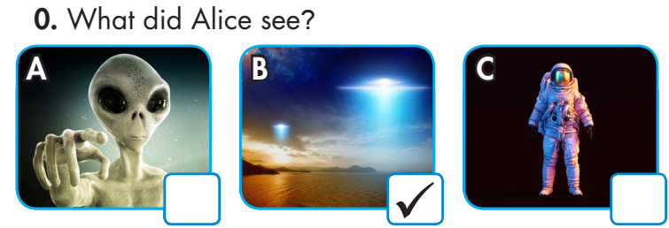
Example:

Slide 11
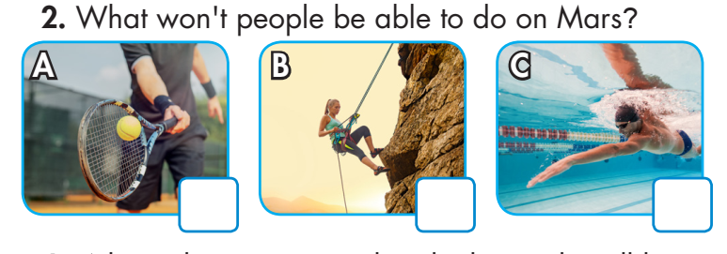
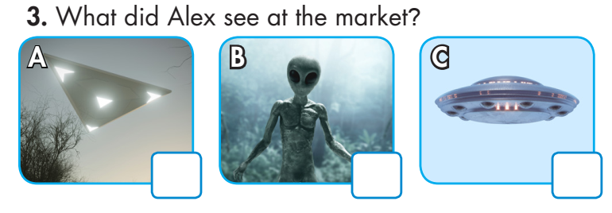

Slide 12
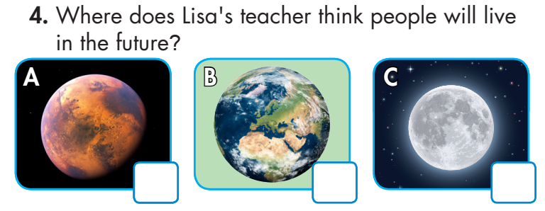
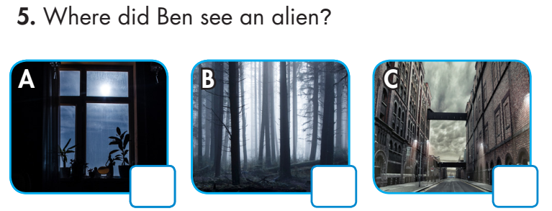

Slide 13
Example:
Alice: Hey, Paul. Paul: Are you OK, Alice? You look worried. Alice: I just saw something really strange. Paul: What happened? Alice: I was walking home when I saw a strange light in the sky.
1.
Narrator: Where does David think people will live in two hundred years?
David: That’s the end of my presentation about space travel. Thank you for listening. Do you have any questions?
Jenny: I have a question, David.
David: Um, yes, Jenny.
Jenny: Where do you think people will live in two hundred years?
David: Hmm. That’s a good question. I think that in two hundred years, people will live on space stations.
Audio Scripts

Slide 14
2. Narrator: What won’t people be able to do on Mars?
Andy: I think I’d like to live on Mars.
Dorothy: Why would you like to live there?
Andy: Mars has beautiful mountains.
Dorothy: It doesn’t have any water, so people won’t be able to go swimming
4. Narrator: What did Alex see at the market?
Alex: John, guess what I just saw.
John: Hey, Alex. What did you see?
Alex: A flying saucer! I was shopping in the market when I saw a round object in the sky. I think it was a flying saucer.
John: Wow! Did you take a photo?

Slide 15
4. Narrator: Where does Lisa’s teacher think people will live in the future?
Lisa: Mr. Keith?
Mr. Keith: Yes, Lisa?
Lisa: Where do you think people will live in the future?
Mr. Keith: I think that people will stay on Earth in the future.
Lisa: Really? Why?
Mr. Keith: Earth is the only place with the perfect temperature and gravity for us.
5. Narrator: Where did Ben see an alien?
Ben: Do you believe in aliens, Nick?
Nick: No, I don’t. Do you?
Ben: Yes, because I saw an alien last week.
Nick: Really? Where?
Ben: It was standing outside my window in the
middle of the night.
Nick: That sounds scary!

Slide 16
Reading

Slide 17
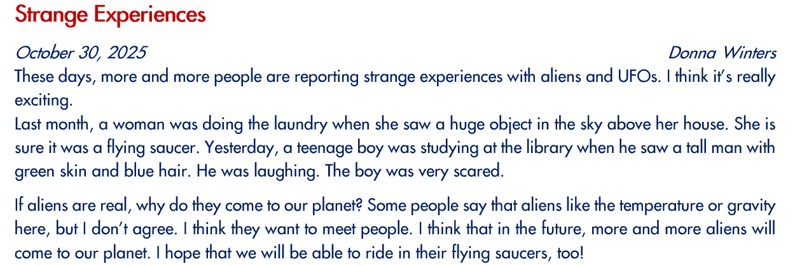

Slide 22
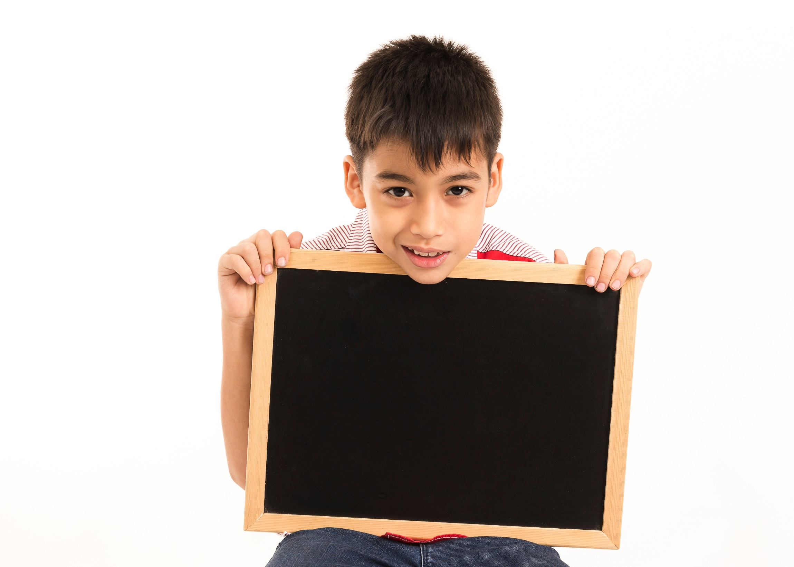
Listening

Slide 23
Extra Practice
WB, page 36
Listen to part of a presentation about UFOs. Fill in the blanks.
the USA
1. People reported more than 90,000 UFO sightings in __________. 2. Most of the time, these UFOs were everyday things like __________ or balloons. 3. In New Jersey, people saw __________ in the sky at night. 4. In __________, someone saw another UFO at an airport in Chicago. 5. The UFO stayed above the airport for about __________.
airplane
strange lights
2006
five minutes

Slide 24
Audio Scripts
Hi, everyone. Thanks for coming to my presentation. Today, I'm going to talk to you about UFOs and flying saucers. In the USA, there have been more than ninety thousand reports
of UFO sightings since 1974! I think most of these were just normal things, like airplanes or balloons. However, there were some that nobody could explain. In New Jersey in 2001,
people were driving home from work at night when they saw strange lights in the sky. There were no airplanes flying in the area at that time. There was another sighting in 2006,
at O'Hare International Airport in Chicago. An airplane was getting ready to take off when a worker saw a disk-shaped UFO. It was in the air above the airport. It stayed there for
about five minutes. Then, it flew upwards very quickly and disappeared. Nobody knows what it was. Finally, I'll tell you what happened to me and my brother last summer. We
were playing soccer in the park at night...

Slide 25
CONSOLIDATION

Slide 26
Extra Practice
WB, page 36
Reading the blog post and answer the questions.
I will never forget the day I met an alien.
I was ten years old. I was with my friend Jonathan. We were climbing trees in the forest near my home.
I was sitting near the top of a tree when I saw a large, green face next to me. It had huge, black eyes, and a tiny mouth. It was looking at me and making strange noises.
I think it was trying to tell me something, but I couldn’t understand its language. I was terrified, but I couldn’t move my body. The alien spoke for about a minute. Then, I saw a strange light and closed my eyes.

Slide 27
Extra Practice
WB, page 36
Reading the blog post and answer the questions.
I will never forget the day I met an alien.
I was ten years old. I was with my friend Jonathan. We were climbing trees in the forest near my home.
I was sitting near the top of a tree when I saw a large, green face next to me. It had huge, black eyes, and a tiny mouth. It was looking at me and making strange noises.
I think it was trying to tell me something, but I couldn’t understand its language. I was terrified, but I couldn’t move my body. The alien spoke for about a minute. Then, I saw a strange light and closed my eyes.
ten years old
Questions: 1. How old was Mike in this story? 2. Where were Mike and Jonathan playing? 3. How did Mike feel when the alien was speaking to him?
in the forest
terrified

Slide 28
WRAP-UP

Slide 29
Today’s lesson:
Review:
- Grammar of Unit 6: Future Simple, Past Continuous and Past Simple
- Vocabulary of Unit 6: Words of the topic “life on other planets”: (Earth, Mars, Venus, oxygen, space station, gravity, temperature, appear, disappear, disk-shaped, flying saucer, huge, tiny, strange, terrified, UFO).
- Listening and Reading Practice to review the topic “Life on other planets”

Slide 30
Homework
- Review vocabulary, grammar and language skills of unit 6.
- Do the exercises in WB: Unit 6 Review - Part 1 (page 55).
- Prepare: Review – SB (page 99)

Slide 31
Lesson 3
Stay positive and have a nice day!

